Slide 1
Legal Challenges in Today’s Military
How 9/11 and Sexual Assault Changed Law
Lt General Richard Harding, USAF, Ret.

Slide 2
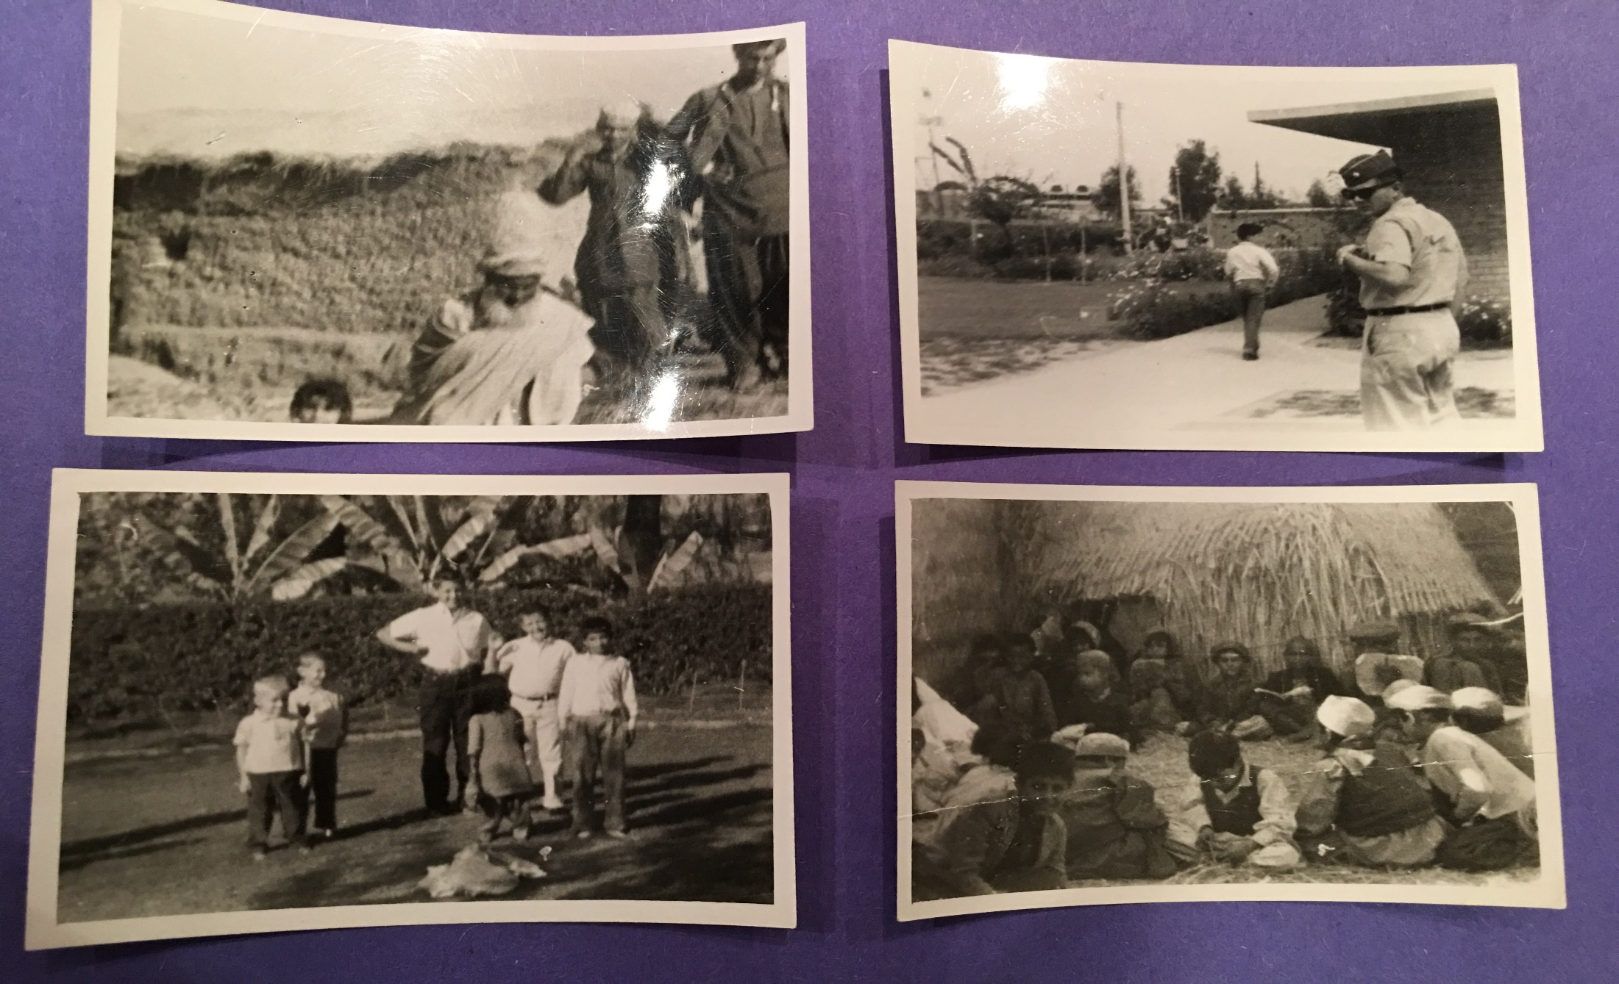
Growing up in Islam Pakistan

Slide 3
Growing up in Pakistan

Slide 4
Growing up in Pakistan

Slide 5
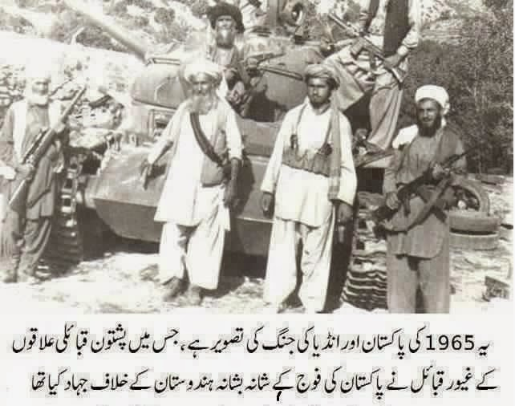
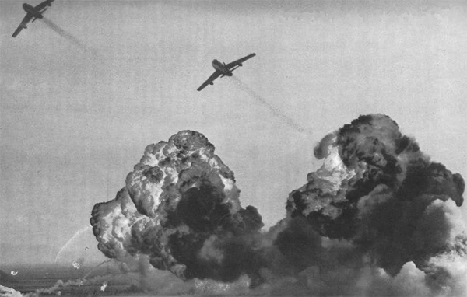
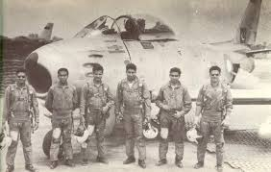
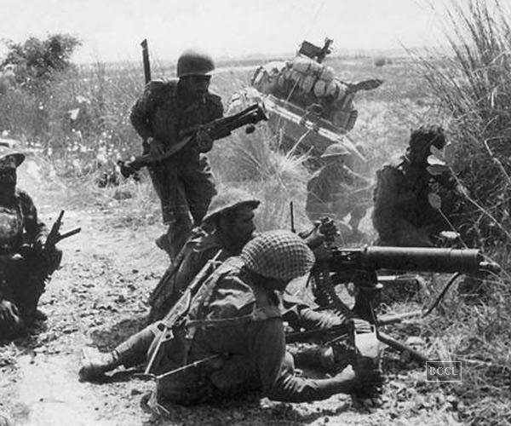
1965 Indo-Pakistan War

Slide 6
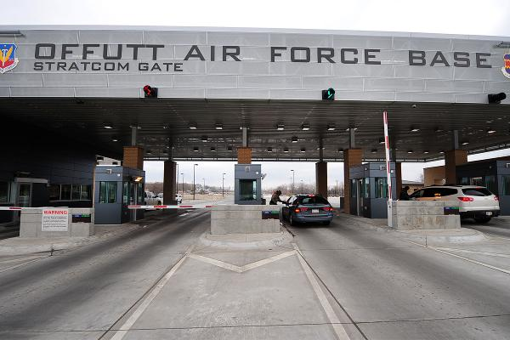
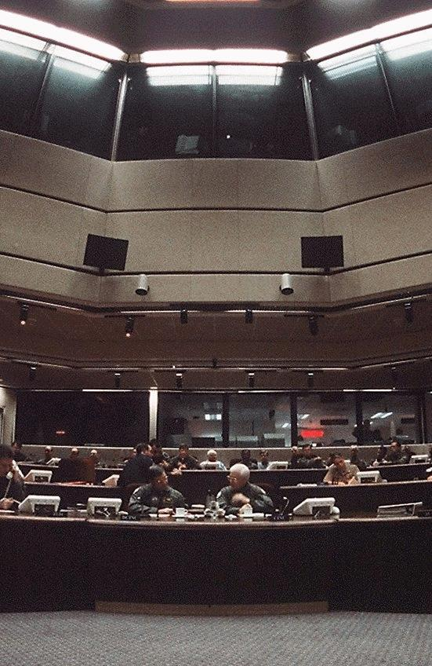
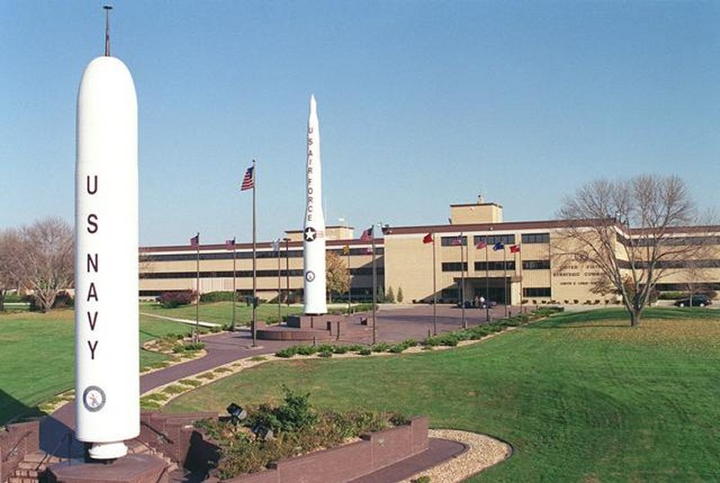
18 Years ago - Just a normal day

Slide 7
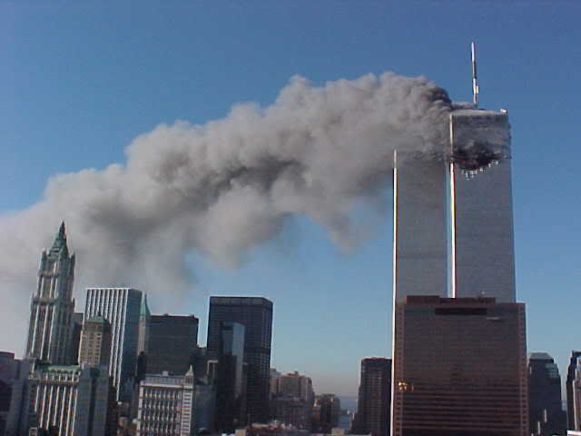
“Sir, we have an actual.”

Slide 8
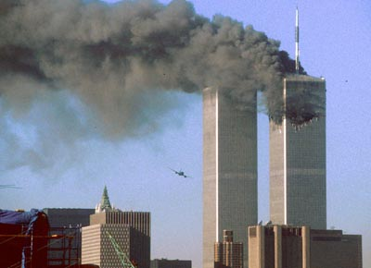
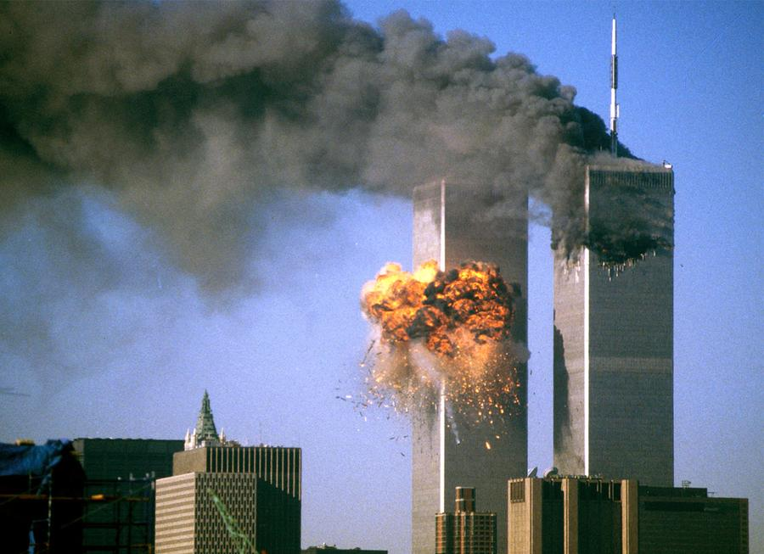
”Sir, we have another actual.”

Slide 9
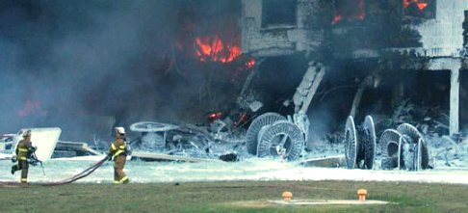
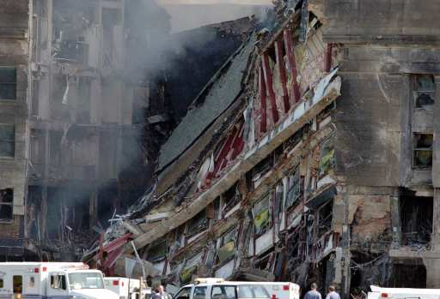
Pentagon under attack

Slide 10
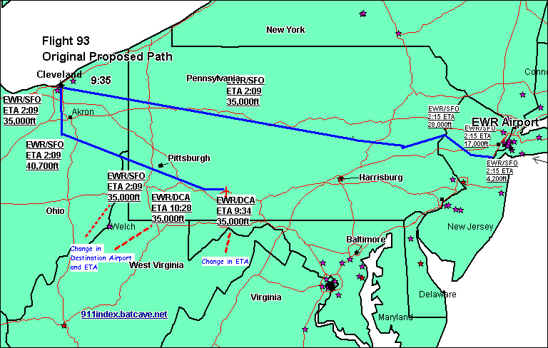
“United 93 has turned” … “TaKe ‘em out”

Slide 11
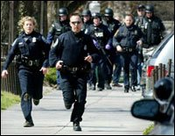
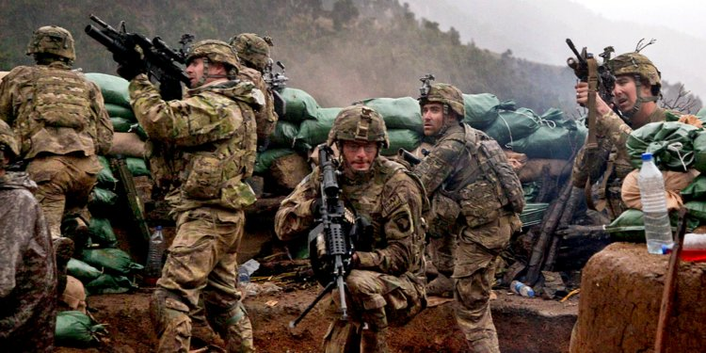
What is Law Enforcement? What is War? NEITHER IS Defined IN LAW

Slide 12
Law enforcement VS. Law Of war
 | Law Enforcement | Law of War
Use of deadly force? | Yes, but only in self-defense or defense of another | Yes, at all times against enemy until asked for quarter
Arrest power? | Yes, based on probable cause | Detention until end of hostilities
Bail available? | Yes. | No.
Right to speedy trial? | Yes. | No trial required; instead preventive detention
Confinement as punishment? | Yes. | No, instead detention until end of hostilities

Slide 13
If this is “war,” who is the enemy?
Who are we fighting today?
“War on terror” is a metaphor
War on “Radical Islam?”
Authorization to Use Military Force (AUMF) 2001
Authorization to Use Military Force (AUMF) 2002

Slide 14
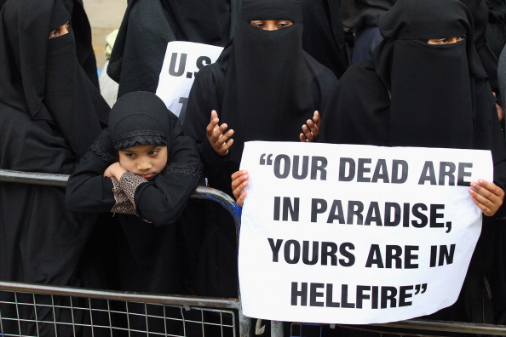
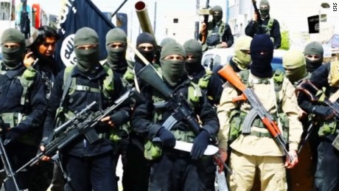
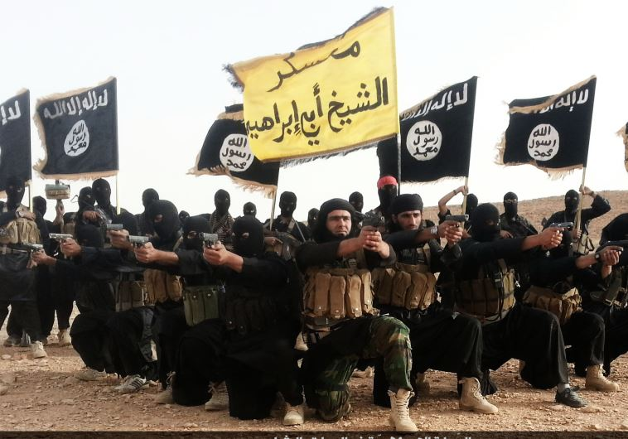
Why they hate us

Slide 15
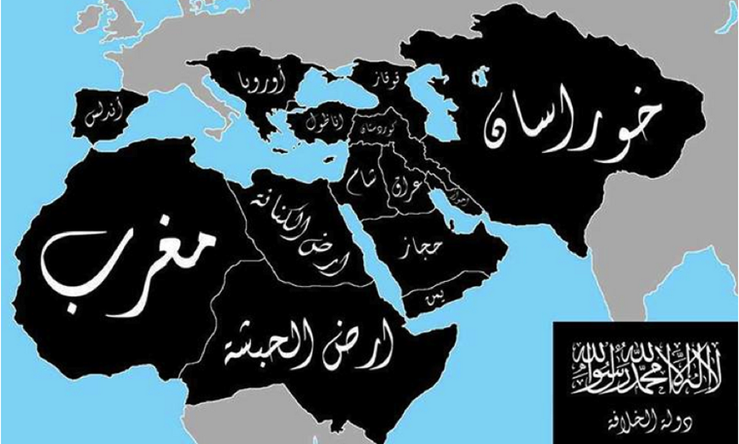
The Spread of Islam

Slide 16
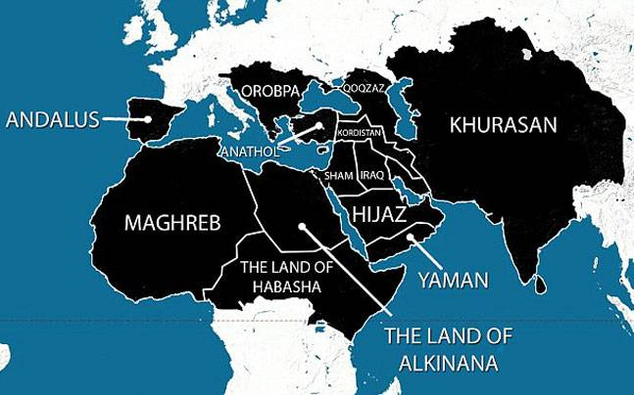
The Spread of Islam

Slide 17
Constitutional War PoWER Authorities
Constitution: Article I, Section 8
“Congress shall have Power to … provide for the common defense.”
“To define and punish Piracies and Felonies committed on the high Seas, and Offences against the Law of Nations”
“Congress shall have Power to … declare War.”
“Congress shall have Power to … raise and support Armies”
“Congress shall have Power to … provide and maintain a Navy”
“Congress shall have Power to … provide for organizing, arming, and disciplining the Militia”

Slide 18
Constitutional Authorities
Constitution Article II, Section1:
(The Vesting Clause): “The executive power shall be vested in the President of the United States of America.”
Constitution Article II, Section 2
(The Commander in Chief Clause): “The President shall be the Commander in Chief of the Army and Navy of the United States”

Slide 19
War Powers Act
President may only commit armed forces to armed conflict
1. by Congressional declaration of war,
2. by other Congressional authorization, or
3. by national emergency created by attack on the US.

Slide 20
War Powers Act
President shall submit within 48 hours to the Speaker of the House of Representatives and to the President pro tempore of the Senate a report, in writing, setting forth—
the circumstances necessitating the introduction of United States Armed Forces;
the constitutional and legislative authority under which such introduction took place; and
the estimated scope and duration of the hostilities or involvement.

Slide 21
War Powers Act
Within sixty calendar days after a report is submitted, the President shall terminate any use of United States Armed Forces, unless the Congress
(1) has declared war or has enacted a specific authorization for such use of United States Armed Forces,
(2) has extended by law such sixty-day period, or
(3) is physically unable to meet as a result of an armed attack upon the United States.

Slide 22
Declared Wars
Wars Declared by Congress
Congress Declared War | Year/President
War of 1812 | 1812/Madison
Mexican-American War | 1846/Polk
Spanish-American War | 1989/McKinley
WWI (Germany) | 1917 Jan/Wilson
WWI (Austria-Hungary) | 1917 Dec/Wilson
WWII (Japan) | 1941 Dec 8/FDR
WWII (Germany, Italy, Bulgaria) | 1941 Dec 11/FDR
WWII (Hungary, Romania) | 1941 Jun/FDR

Slide 23
Wars Authorized by Congress
War Authorized by Congress | Year/President
Quasi War with France | 1798/Adams
First Barbary War with Tripoli | 1802/Jefferson (after the war)
Second Barbary War with Algiers | 1815/Madison (after the war)
Slave Trade Ban | 1819/Monroe
Redress attack on USS Water Witch with Paraguay | 1858/Buchanan
Occupation of Veracruz | 1914/Wilson
Intervention in Russian Civil War | 1918/Wilson
Intervention in Lebanon to hold Socialist Party | 1958/Eisenhower
Vietnam War | 1964/Johnson
Multinational Force to Lebanon | 1983/Reagan
Persian Gulf War | 1991/H.W. Bush
OEF (Afghanistan) | 2001/W. Bush
OIF (Iraq War) | 2001/W. Bush

Slide 24
Wars Neither Declared, nor Authorized by Congress
Wars Not Authorized by Congress | Year/President
Indian Wars | 1790 – 1890 multiple
Seizure of West Florida | 1810/Madison
Invasion of Spanish Florida to chase Seminoles | 1814/none - General Jackson
Civil War | 1861/Lincoln
Invasion of Nicaragua; begins occupation thru 1933 | 1912/Wilson
Invasion of Mexico to find Poncho Villa | 1916/Wilson
Korean War | 1950/Truman
Operation Urgent Fury (Granada) | 1983/Reagan
Operation Just Cause (Panama) | 1989/H.W. Bush
Operation Restore Hope (Somalia) | 1992/H.W. Bush
Bosnia, Kosovo | 1999/Clinton
Libya (Administration claims no “hostilities) | 2011/Obama
Syria and arguably Iraq Should AUMF’s be time limited? (i.e., Iraq 2002 AUMF)? Congress authorizes funds for $58.6 billion for Overseas Contingency Operations for military activities (arguably included Syria). Jack Goldsmith argues that Congress authorized military force thru appropriations power | 2014/Obama

Slide 25
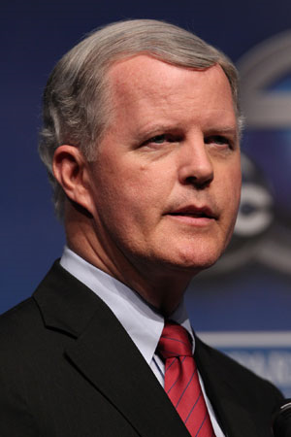
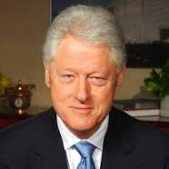
Can Art III courts resolve confusion between Art I and Art II?
Campbell v. Clinton, DC Circuit (2000)
Clinton sends War Powers Act notice to Congress about Yugoslavia bombing campaign
House voted down declaration and AUMF
Clinton continued to bomb
Rep Tom Campbell + 29 other House member sue Clinton for not withdrawing Yugoslavia bombing campaign
DC Dist and Circuit held this was political question; no standing
Clinton ended bombing campaign before 90-day limit

Slide 26
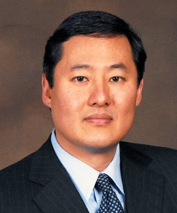
Does Constitution require declaration of War or AUMF before US goes to war for more than 60/90 day limit?
The Flynn
No Argument: Constitution grants President absolute war making authority
Commander-in-Chief & Vesting Clauses are enough authority
Unitary executive theory
War Powers Act is unconstitutional
President can act in both self-defense and anticipatory self-defense w/o Congress (Yoo)
“declare war” means provide notice to other nations, nothing more (Yoo)
Congress’ only authority is stop funding of war
AUMF from Congress is just political support of President’s decision

Slide 27
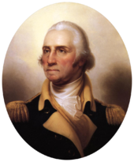
Does Constitution require declaration of War or AUMF before US goes to war for more than 60/90 day limit?
Yes Argument: Constitution grants President immediate self-defense authority, nothing more
Commander-in-Chief is command and control authority
War Powers Act gives President time to go to Congress for long-term war-making authority
Constitutional Convention record
Federalist 69 explain limits to Commander-in-Chief and Vesting Clauses
In re Quirin dicta: “Constitution invests the President as Commander-in-Chief with power to wage war which Congress declares”

Slide 28
EXPANDING PRESIDENT’s War powers to include “associated forces”
2012 Jeh Johnson’s Harvard speech:
1. “entered the fight alongside al Qaeda”
2. is a “co-belligerent with al Qaeda in hostilities against the United States”
“Co-billigerency” is international law authority, not domestic law authority
Ex: Congress declared war against each Axis power in WWI & WWII

Slide 29
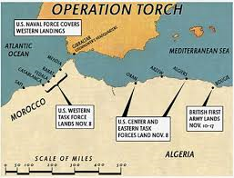
War Declaration authority CHANGE: “Associated Forces”
2012 Jeh Johnson’s Harvard speech
Goldsmith’s Harvard Law Review article cites Operation Torch
Jeh Johnson removes Operation Torch from speech and explains “assoc forces”

Slide 30
Congress’ reaction to “Associated Force”
2013: Congress refused to amend 2001 AUMF to include “associated forces”
2013: Congress amended authority to detain combatants to include “associated forces”
2015: Steve Preston uses “associated forces” to justify war against ISIS

Slide 31
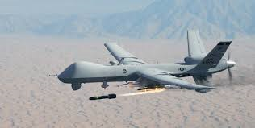
President’s expanded war powers: Targeted Killing
Obama legal standard for targeted killing. 6-part test:
Targeted individual is AQ or “associated forces”
Individual posses “continuing, imminent threat”
Capture is not feasible
“Near certainty” that civilians will not be harmed
Consistent with law of war
Consent of host country or host is “unwilling or unable” to consent
Targeted killing is not prohibited “assassination” under EO 12333
Is targeted killing something that can used against the US? Can we object/prosecute?

Slide 32
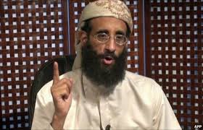
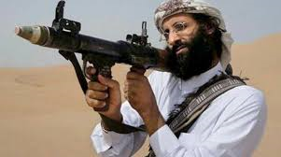
Targeted Killing Against US citizens
The case of Anwar Awlaki:
A kill list of US citizens
Alleged denial of due process. No notice or opportunity to defend.
Political question
No standing

Slide 33
Expansion of the Right to Wage War:
Recent attempts to abandon the purpose of the Law of War, to reduce the incidents of war
Expanding jus ad bellum self-defense continuum
Actual SD → Anticipatory SD → “continuing immense” → preemption → prevention

Slide 34
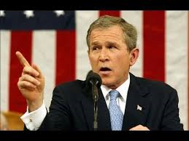
Expansion of the Right to Wage War:
Chaney 1% doctrine results in Bush doctrine
Don’t wait for “smoking gun evidence” that could be a “mushroom cloud” Condi Rice, NSA
WH white paper on preemptive war and “Axis of Evil”
Bush speech warning on the Axis of Evil
3 countries: Iraq, Iran, North Korea
John Bolton (Asst Sec State, adds Libya, Syria and Cuba)

Slide 35
Another Challenge …
SEXUAL ASSAULT IN THE MILITARY

Slide 36
Sexual assault in the military
Every 2 years annoynoumous survey in military
26,000 sexual assaults in 2012
2012 reporting rate is 11%
Only 20% sexual rape complaints prosecuted (RAINN civ stats are equal)
Popular solution: end commanders’ authority to prosecute
Hurts military effectiveness

Slide 37
Sexual assault in the military
Solution = ↑ reporting → ↑ prosecutions → ↑ deterrence → ↓ prevalence
Solution: Sexual Assault Counsel
Takes burden off victim
“Voice and choice”
Ethical duty of confidentiality and zealous representation
r% sexual rape complaints prosecuted (RAINN civ stats are equal)
SVCs advocate for:
Job transfer
Prosecution/no prosecution
Medical care for MST
Assist in interviews

Slide 38
Sexual assault in the military
Resistance
All 4 criminal justice communities: LE, TCs, DCs, military judges
All other services (including mine)26,000 sexual assaults in 2012
SECDEF sent advisor to meeting: “What is your concern ?”
Briefed JCS in Tank: concern was manpower
Sec of USAF calls other service secretaries: USAF agrees to “pilot program”
Congress briefed: Congress passes 10 USC 1044e, mandating SVC program

Slide 39
Sexual assault in the military
SVC qualifications (USAF)
Previous TC or DC
Not all services agree
TJAG selects
Regional coverage
Training with NCVLI

Slide 40
Sexual assault in the military
LRM v. Kastenberg
LRM v. Kastenberg
Trial judge denies SVC right to speak
3 times in Rules of Evidence that victim can speak
Rape shield (MRE 412)
Psychotherapist privilege (MRE 513)
Victim advocate – Victim privilege (MRE 514)
On appeal, mandamus requested
AFCCA: unsure of mandamus as remedy – denies appeal
CAAF: overturned trial judge’s ruling – victim has right to be heard through counsel
Case cited today in civilian courts

Slide 41
Results of SVC Program

Slide 42
Unequal Increases in sexual assault by service

Slide 43
SVC Program Next Steps
ABC news: SVCs overworked; unexperienced; commanders unexperienced
Response: S.1500/ May 2019: “Military Special Victims Protection Act”
↑ number of SVCs
↑ training
Referral of charges by O-6 or above
Review by STC or SPC
SVC will represent civilian victims
SVC must relay victim’s desire of whether to go to trial

Slide 44
Questions ?
Thank you for your attention

Slide 45
BACKUP SLIDES

Slide 46
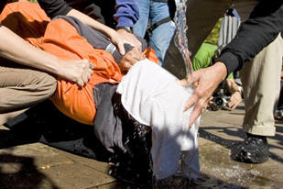
Enhanced Interrogation
DOJ/OLC Torture Memo (Yoo)
TJAGs not allowed to see memo
Goldsmith criticism of torture memo; rescinds memo
Repealed by DOJ/OLC
Detainee Treatment Act of 2005
2015 McCain Amendment
Does torture work?
Would torture be justified to find a dirty bomb in Atlanta? Defense of necessity?

Slide 47
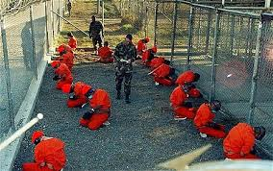
CHANGES IN Detention LAW of enemy combatants
Detention until the end of hostilities
Detention vs. Punishment
Coalition partners not happy… human rights law
Mil Commissions confused purpose of detention
Outside US meant to avoid habeas jurisdiction
Hamdi v. Rumsfeld (2004) said habeas applies to GTMO

Slide 48
WHY care about war authorizing powers?
Endless war is possible because:
Congressmen see political risk in voting for/against war
Ex: Vote on 2002 Iraq AUMF
Executive branch sees political risk in asking for AUMF from Congress
Courts decline to settle the issue
Do constituents care about this, if their children will not be drafted?
18YO voting habits
Who ensures we have a winning military strategy? Is “hitting back” a strategy?
At what point do we exhaust US armed forces and war materiel?
Do we bring back the draft?

Slide 49
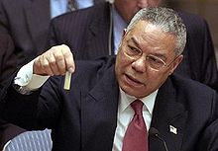
Expansion of the Right to Wage War: jus ad bellum CHANGE
Bush Doctrine leads to War in Iraq
Curveball
yellow cake
Chaney presses intel community
Little evidence of WMD or Saddam allied with terrorists
2002 AUMF
UN Resolution 1441 & Colin Powell’s speech to the UN
War starts in March 2003
Result #1 → di-Bathifaction → insurgency → political instability → collapse of Iraqi gov’t → rise of ISIS
Result #2 → rise of Iranian nuclear program and state sponsored terrorism (improvised explosive projectiles and Hezbollah)

Slide 50
jus ad bellum CHANGE: TARGETED KILLING
MQ-1 Predator: early intel use in Afghanistan
MQ-9 Reaper: hellfire and GBU-12
Advantages of drone
Anwar Awlaki drone strike in Yemen, but we are not at war with Yemen or AQAP
Common criticism: dangers of robotics
Legal concern: Expanding jus ad bellum self-defense continuum
Actual SD → Anticipatory SD → “continuing immense” → preemption → prevention

Slide 51
Targeted Killing
Obama legal standard for targeted killing. 6-part test:
Targeted individual is AQ or “associated forces”
Individual posses “continuing, imminent threat”
Capture is not feasible
“Near certainty” that civilians will not be harmed
Consistent with law of war
Consent of host country or host is “unwilling or unable” to consent
Targeted killing is not prohibited “assassination” under EO 12333
Is targeted killing something that can used against the US? Can we object/prosecute?

Slide 52
Jus in Bello Change: Signature strikes
All SUVs in Afghanistan?
Abdul Rahman Awlaki killed 2 weeks after his father
Lack of positive ID
Does the “duck rule” have a place in international and US law?

Slide 53
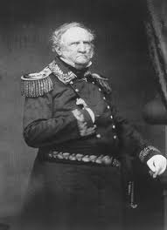
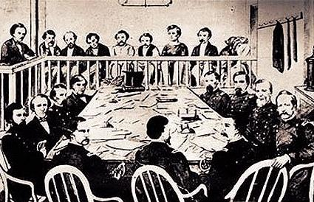
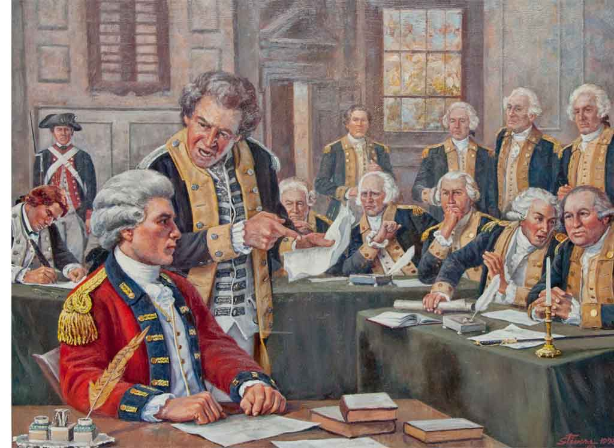
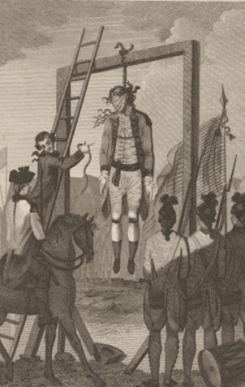
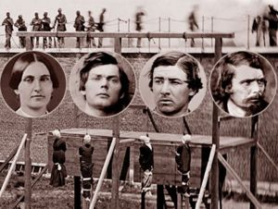
Legal remedies for detainees: History of Military Commissions
Revolutionary War: Trial of Maj Andre
Mex-Am War: Gen Scott convenes MC for Mex Army & civilians
Civil War: Lincoln conspirators tried by mil commission

Slide 54
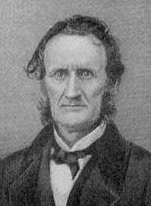
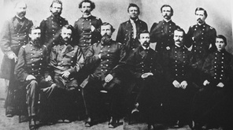
Legal remedies for detainees: Ex Parte Milligan, 71 US 2 (1866)
Art I, Sec 9: writ of habeas corpus shall not be suspended unless in cases of rebellion or invasion the public safety requires it
1862 Lincoln suspends habeas corpus and establishes mil commissions
1863: Congress limits suspension, requiring those in union states to be turned over to federal courts
1864: Maj Gen Hovey convenes mil commission in Indianapolis to try Southern sympathizers; 3 sentenced to hang; habeas appeal to USSC
Held: writ of habeas corpus cannot be suspended
1. in states not in rebellion
2. Where federal courts are functioning
3. The petitioner is not a member of the enemy force

Slide 55
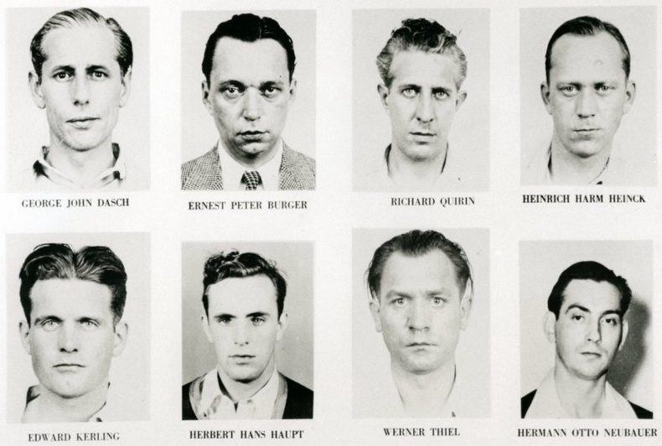
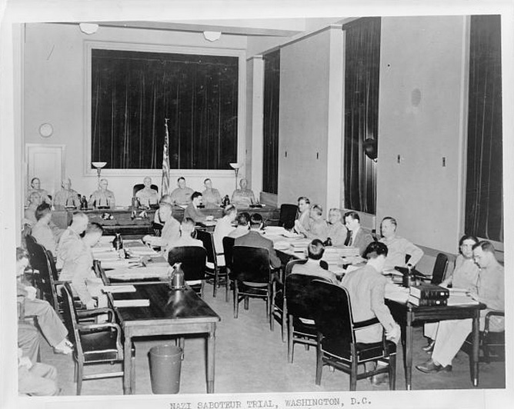
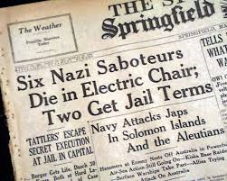
Legal remedies for detainees: Ex Parte Quirin, 317 US 1 (1942)
German saboteurs landed in US by subs
All 8 sentenced to death
Habeas petition to USSC
Held: mil com has criminal jurisdiction over enemy combatants, even US citizens
Rationale:
Congress must authorize mil commission, IAW Art. I, Sec.:
- Congress has authority to define and punish violations against “Laws of Nations”
Haupt’s US citizenship did not exempt him from trial by mil commission
Milligan distinguished

Slide 56
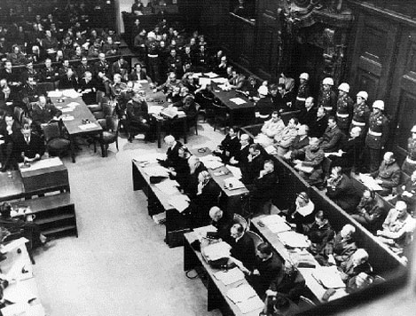
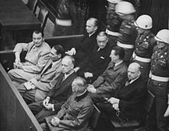
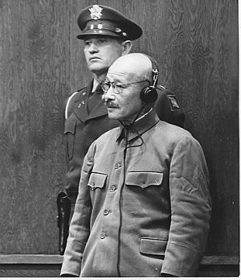
Nuremberg and Japanese Tribunals
Overseas tribunals
Nuremberg was International, vice US, military commission
Victors’ justice with a political messaging purpose
Crimes against peace and crimes against humanity

Slide 57
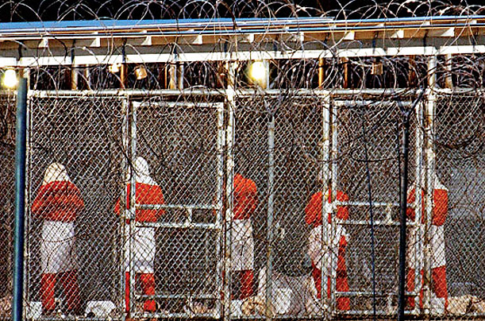
Early post 9-11 Decisions on Detainees
Where to house detainees? In US? Outside US?
Administration tried to follow Johnson v. Eisentrager, 339 US 763 (1950)
Political decision to avoid federal courts’ habeas jurisdiction.
Bush Administration decides AQ and Taliban are “unlawful enemy combatants”
Based on OLC opinion
Unified Command SJAs challenged OLC memo
Bush Administration concludes
UEC not entitled to Common Article 3 rights
UEC not entitled to Article 5 Detainee Review Boards
Political pressure resulted in Bush Administration saying the AQ and Taliban would be accorded rights similar to Geneva Convention

Slide 58
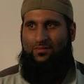
Legal remedies for detainees: Rasul v. Bush, 542 US 466 (2004)
British citizen
Captured in Afghanistan
Held in GTMO
Petition for habeas corpus
Appealed to USSC
Held: right to habeas corpus can be exercised in all dominions under sovereign US control, even if not on sovereign US territory.
Rationale: Court “reinterpreted” Johnson v. Eisentrager, 339 US 763 (1950). US control over GTMO different than US control over post-war Germany
GTMO is lease in perpetuity with exclusive US control.

Slide 59
Legal remedies for detainees: Hamdi v. Rumsfeld, 542 US 507 (2004)
US citizen, born in Louisiana
Family moved to Saudi Arabia
Captured in Afghanistan; moved to GTMO
Petition for habeas corpus
Appealed to USSC
Held: US citizen enemy combatant can periodically contest the basis detention
Rationale:
US citizen who is enemy combatant may be detained (In re Quirin)
US citizen has a due process right to challenge enemy combatant status
“…a state of war is not a blank check for the President when it comes to the rights of its citizens.”

Slide 60
Result of Rasul and Hamdi
Bush Admin. Creates Combatant Status Review Tribunal (CSRT).
3 senior officers
Detainee represented by a JAG
Obama changed CSRT at GTMO to interagency Guantanamo Review Task Force
Congress now requires 15-day notice before release
780 detainees at GTMO → down to 41
Congress included CSRT process in 2005 Detainee Treatment Act (DTA) and 2006 Military Commissions Act (MCA).
2006 MCA said CSRT was the only recourse (exclusive habeas remedy) for alien enemy combatants.
US policy : move enemy combatants who are US citizens to federal custody in US

Slide 61
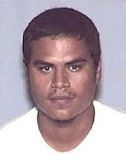
Legal remedies for detainees: Padilla v. Hanft, 4th Circuit, No 05-6389 (2005)
Jose Padilla is US citizen
Fought in Afghanistan
Fled to Pakistan; trained by Al Qaeda
Returned to US to blow up apartment buildings
Arrested at Chicago airport
Alleged must be tried in US district court, not detained
Held: Locus of capture does not define President’s right to detain enemy combatants.
Rationale: consistent with Milligan and Quirin

Slide 62
Legal remedies for detainees: Boumediene v. Bush, 553 U.S. 723 (2008)
Lakhdar Boumediene, naturalized citizen of Bosnia and Herzegovina
Detained at GTMO, subject to US habeas jurisdiction (IAW Rasul)
Petitions US Dist Ct for habeas
Contends: 2006 MCA is not exclusive remedy
Contends: Suspension Clause has not been triggered;
therefore, habeas in fed court is still a right of GTMO detainees
Suspension Clause: “The Privilege of the Writ of Habeas Corpus shall not be suspended, unless when in Cases of Rebellion or Invasion the public Safety may require it.”
Held: Suspension Clause not triggered; therefore, detainees in GTMO have a right to have federal courts hear their habeas petitions.

Slide 63
Legal remedies for detainees: Al-Bihani v. Obama, Ct of Appeals for DC, No 09-5051 (2010)
Yemini citizen
Traveled to Afghanistan and joined 55th Arab Brigade
Captured by Northern Alliance
Turned over to US; detained at GTMO
Petition for habeas
Held: International law of co-belligerency does not allow Arab Brigade to declare neutrality before Al-Bihani may be lawfully detained under domestic law
Held: Habeas proceedings for war detainees need not follow the same rules as criminal habeas proceedings

Slide 64
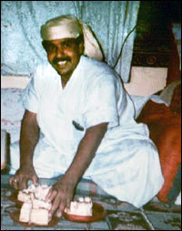
Legal remedies for detainees: Hamdan v. Rumsfeld, 548 U.S. 557 (2006)
Hamdan is a Yemen citizen
Captured with Taliban
In custody at GTMO
Held: Procedures for Military Commissions lack basic evidentiary requirements required by Art III courts and international law (Common Article 3)
Rationale: UCMJ Art 36 and Common Article 3 of Geneva Convention requires more procedural and evidentiary safeguards

Slide 65
Legal remedies for detainees: 2009 Military Commissions Act
Detainee Rights | Detainee Rights
Copy of charges | Accused may see every piece of prosecution evidence
Right to free military attorney | Right to be present unless disruptive and unless closed for national security reasons
Presumption of innocence | Appointment of interpreters
Guilt proven by proof beyond reasonable doubt | Access to sentencing evidence
Access to evidence tending to exculpate | No double jeopardy after verdict is final
Right to remain silent | May challenges panel members
No adverse inference for remaining silent | 2/3rds to agree on guilt
Right to testify subject to cross-examination | Unanimous decision for death penalty
Right to obtain witnesses for defense | Public trial
Right to present evidence and cross-examine | Automatic appeal to CMCR
No statement obtained by torture admissible | Further review by DC Circuit; then USSC

Slide 66
CIA is a Warfighter
CIA has its own Air Force
CIA recruits many ex-military for warfighting
CIA agents are unprivileged combatants
Problems with CIA as a warfighter:
1. Accountability:
2. Diverts CIA from core competency (intel gathering) & duplicates DOD Special Ops
3. Instead CIA is target hunting
4. CIA is not in uniform; sets bad example for other
How can we complain when other nations do the same?
KGB/GRU, Quds Force?

Slide 67
Contractors on the Battlefield
Problem: many contractors on battlefield
Not enough uniformed security forces
Ex: State and Justice Dept.
Historic lack of criminal accountability
UCMJ Art 2: includes persons accompanying armed force in combat
MEJA (Military Extraterritorial Jurisdiction Act) of 2000 expands federal jurisdiction
Federal acquisition regulations requires notice to contractor employees

Slide 68
ethics in national security law
EO 13490: gifts, lobbying, avoidance of conflicts of interests
Administered by OGE
Covers all federal employees except the President
Code of Professional Responsibility for attorneys
Uniformed services CPRs and disciplinary processes
ABA Model Code of Profession Responsibility used
DOJ has OPR, issues ethical rules for attorneys; has disciplinary processes

Slide 69
ethics in national security law
Who is the Client?
ABA Model Code: duty of atty who represents an organization: Rule 1.13 “Organization as Client”
Ex. DOJ persons who thought President was client over their obligation to the People:
John Mitchell

Slide 70
ethics in national security law
Question #1: When OLC writes an opinion, should it discuss the policy and pragmatic implications of its opinion?
What is the duty to the client?
ABA Model CPR Rule 2.1: “In representing a client, a lawyer shall exercise independent professional judgment and render candid advice. In rendering advice, a lawyer may refer not only to the law but to other considerations such as moral, economic, social, and political factors, that may be relevant to the client’s situation.”
Case study: DOJ/OLC’s torture opinion failed to warn of practical infirmities (OPRs recommendations re John Yoo)

Slide 71
ethics in national security law
Question #2: When OLC writes an opinion, should it attempt to justify what the President wants to do?
Ex: Enhanced interrogation
Bottom line: agency professional lawyers are loyal to the agency. Political appointee lawyers are loyal to the Administration.

Slide 72
ethics in national security law
Question #3: Should political appointee lawyers exclude career agency lawyers from drafting or consulting on law of war opinions?
Difference in view of institutional attorneys and political appointee attorneys.
Ex: Unlawful enemy combatant memo; torture memo
Case study: attempts to marginalize JAGs
10 USC 8037: AF TJAG is “the legal advisor” to the Secretary and provides “independent legal advice”
Mission Directive giving “controlling legal opinions” to GC over TJAG.
AF JAG stripped of 50% of its general officers

Slide 73
ethics in national security law
Question #4: Transparency: Should OLC’s opinion be shared with the public?
FOIA: General rule = release all government records (paper and electronic) unless one of 9 exemptions apply.
FOIA exemption #1: Classified data. Why are legal opinions classified?
FOIA exemption #5: deliberative process privilege and atty-client privilege
Duty to reasonably segregate
Why release new war rules of law only in speeches?
Ex: targeted killing legal rules
Public policy reasons for transparency in legal opinions
builds trust and confidence
strengthens “rule of law”

Slide 74
The Worldwide Governance Indicators, a research program of the World Bank. captureS six key dimensions of Governance … Voice & Accountability, Political Stability and Lack of Violence, Government Effectiveness, Regulatory Quality, Rule of law, and Control of Corruption … between 1996 and 2005
Case #5: RULE OF LAW CONFLICT ZONES
rank indicates the percentage of countries worldwide that rate below the selected country.
90 – 100th percentile
75 – 90th percentile
50 – 75th percentile
25 – 50th percentile
10 - 25th percentile
0 -10th percentile

Slide 75
Final thoughts: What a winning strategy looks like
Strengthen weak governments
Secure populations in weak ROL states
Defeat ISIS
Use containment strategy for jihadists
Recognize containment takes time
Use counter-messaging because it’s an ideological war
Attack conditions creating hopelessness
Continue counter-terrorism strikes
Limit strikes to vital US interests
Simultaneously prepare for war with peer competitors

Slide 76
Fighting terrorists can evolve into Insurgency

Slide 77
Customary International law – 2000 years in development

Slide 78
Jus AD BELLUM: Justification for war
Wars to acquire resources (discredited as illegal wars of aggression)
Religious war to support spread of theology (discredited)
St Augustine’s Just War Theory (well respected)
Defense of nation (self-defense)
Anticipatory self-defense (nuclear first launch)
Preventive war? (Bush Doctrine)

Slide 79
Jus in bello: Restrictions in war
Principle of military purpose (positive ID)
Proportionality
Discrimination
Defense of nation (self-defense)
Avoidance of unnecessary suffering
Protected places and members of armed force

Slide 80
Treaty law Jus ad bellum
Kellogg-Briand Pact (1928)
Outlaws war (US reservation for self-defense)
League of Nations (1920)
US did not join
UN Charter (1945)
Recognizes right of self-defense

Slide 81
Treaty law Jus IN Bello
Hague Conventions (1899 and 1907)
Outlaws war (US reservation for self-defense)
Nuremberg Charter (1945)
Defined crimes against peace, crimes against humanity
Geneva Conventions (1864, 1906, 1929, 1949)
Addresses national wars and “non-international armed conflict in Common Article 3)

