Slide 1
Doing Well by Doing Good
University of Missouri School of Law Veterans Clinic
6th Annual Symposium – Nov. 8, 2019
Presenter: Amy B. Kretkowski, Veterans Law Attorney
Adjunct Professor, Veterans Benefits Law,
University of Iowa College of Law

Slide 2
Missouri Rules of Professional Conduct
Preamble
A lawyer should be mindful of deficiencies in the administration of justice and of the fact that the poor, and sometimes persons who are not poor, cannot afford adequate legal assistance. . . .

Slide 3
Missouri Rules of Professional Conduct
Preamble
. . . All lawyers, therefore, should devote professional time and resources and use civic influence to ensure equal access to our system of justice for all those who because of economic or social barriers cannot afford or secure adequate legal counsel.

Slide 4
Missouri Rules of Professional Conduct
Rule 4-6.1: Voluntary Pro Bono Publico Service
A lawyer should render public interest legal service. A lawyer may discharge this responsibility by providing professional services at no fee or a reduced fee to persons of limited means or to public service or charitable groups or organizations; by service in activities for improving the law, the legal system, or the legal profession; and by financial support for organizations that provide legal services to persons of limited means.

Slide 5
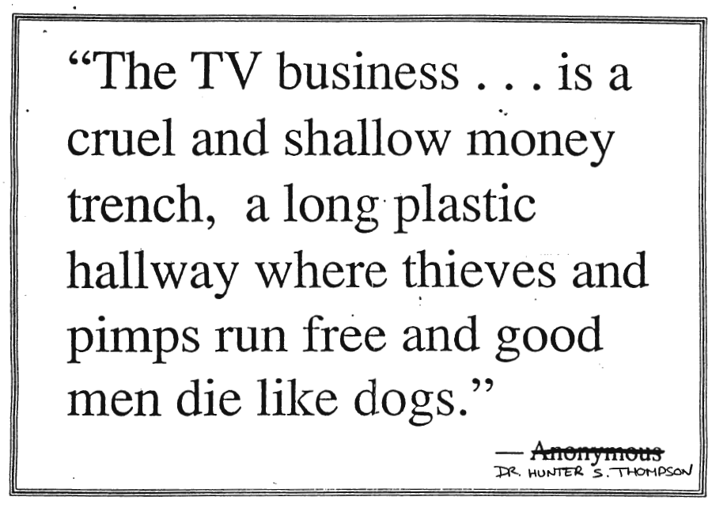

Slide 6







0

Slide 7


Slide 8
The purpose of human life is to serve, and to show compassion and the will to help others.
Albert Schweitzer

Slide 10
Case study: Stephen
Vietnam combat veteran
Declared incompetent by VA to handle his financial affairs after being granted service connection for PTSD, rated 100%.
Has ongoing issues with his VA-appointed fiduciary.
His doctor says he’s competent.
He wants “his life back.”

Slide 11
Case study: Ron
Homeless Vietnam veteran
VA stops pension because of an outstanding arrest warrant
Warrant cleared
VA reinstates pension – and withholds it all because he owes VA $74,000

Slide 12
Case study: Leon
Vietnam combat veteran
Denied VA benefits by multiple regional offices since 1970s because of dishonorable discharge
Back-to-back enlistments
Service records contain two prior DD214s – honorable discharge

Slide 13
See one
Do one
Teach one

Slide 14
Benefits of volunteering
Volunteering is predictive of
  better mental and physical health,
  life satisfaction,
  self-esteem,
  happiness,
  lower depressive symptoms, psychological distress, and
  mortality and functional ability.
One study found that people who volunteer regularly are less likely to develop high blood pressure.

Slide 15
Top five unmet legal needs of homeless veterans:
eviction and foreclosure
driver’s license restoration
child support issues
outstanding warrants and fines
discharge upgrades

Slide 16
Missouri Bar Association www.mobarprobono.net

Slide 17
American Bar Association
Standing Committee on Pro Bono and Public Service www.americanbar.org

Slide 18
Legal Aid of Western Missouri
  https://lawmo.org
Legal Services of Eastern Missouri
  https://lsem.org
Mid-Missouri Legal Services
  https://mmls.org

Slide 20
Questions, Comments, ideas?
Amy B. Kretkowski
T: 319-337-8899
E: amy@abkveteranslaw.com

