Slide 1
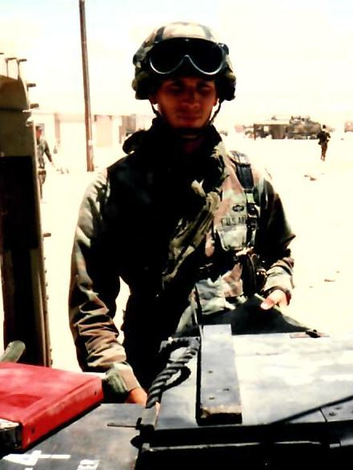
The 24th Infantry Division (Mech) in Desert Storm “Violence…Protect Your Honor…Pray” Greg Bier
Maj Gen Barry McCaffrey
From the Mohave’ Desert to the Saudi & Iraqi Desert
Began the deployment to Saudi Arabia with the 24th Infantry six days after Iraq invaded Kuwait in August 1990.
Over the course of a few weeks the 24th Infantry moved 1,600 armored vehicles, 3,500 wheeled vehicles, 90 helicopters, and 18,000 soldiers over 8,000 miles into the desert of Saudi Arabia.

Slide 2
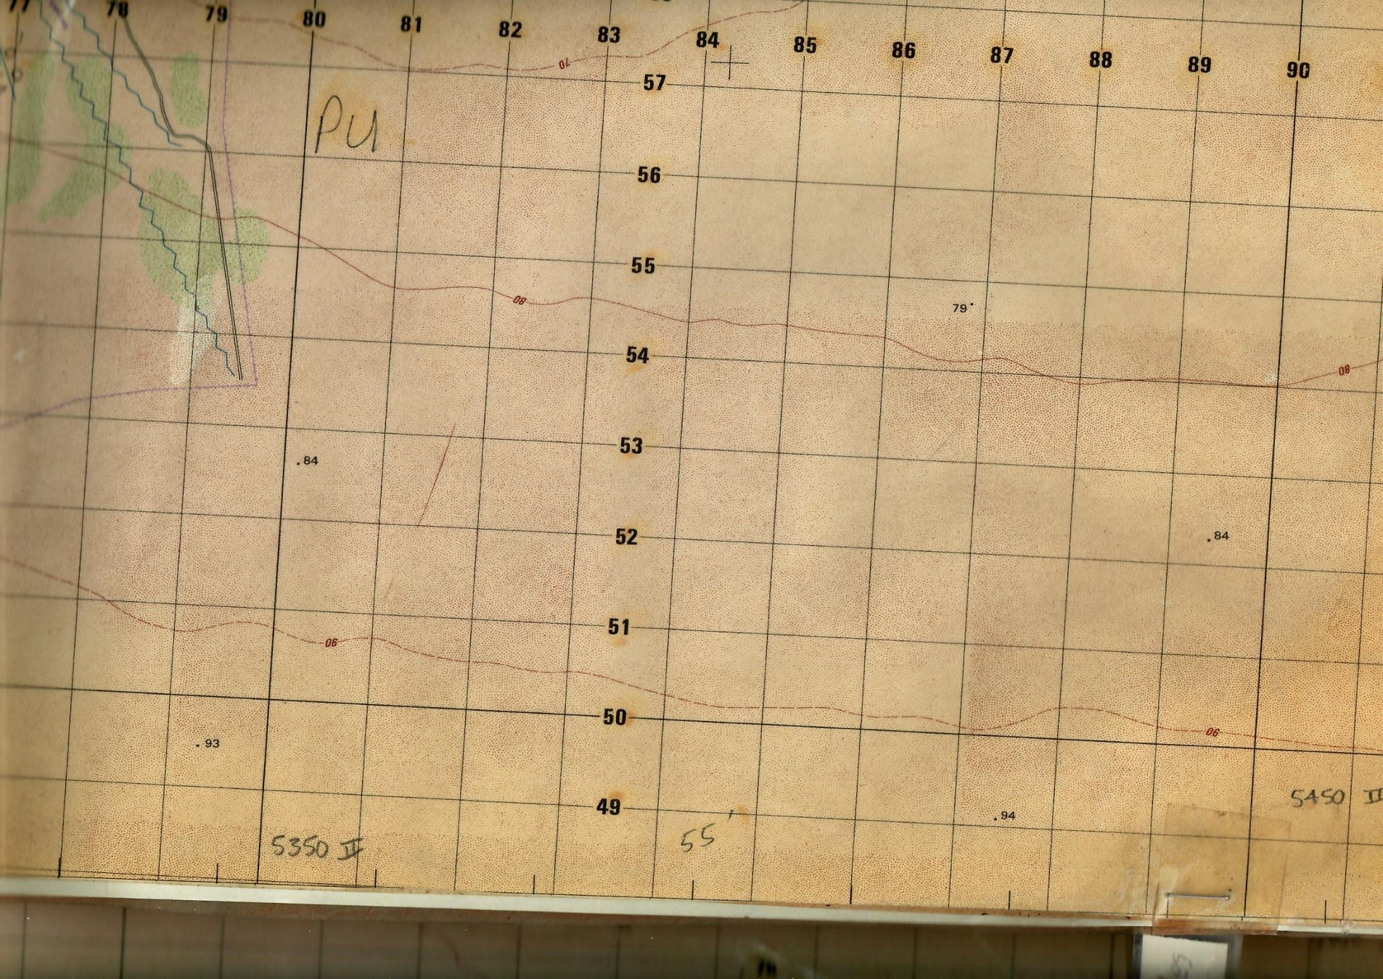
24th Infantry Area of Operations
No water
No electric
No shelter
No bathrooms
No showers
No A/C
No heat
No cable TV, email, or WiFi
Thriving on HARDSHIP
builds mental toughness

Slide 3
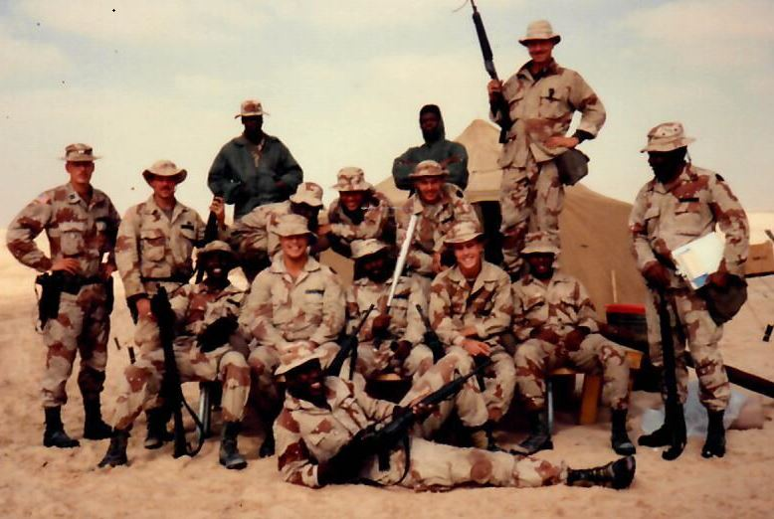
EVERYTHING had to be supplied to us (regularly)
Water bottles
Fuel/oil
Medical supplies
Food
Ammunition
Spare parts
Batteries
Tires
Construction material
Care packages from home

Slide 4
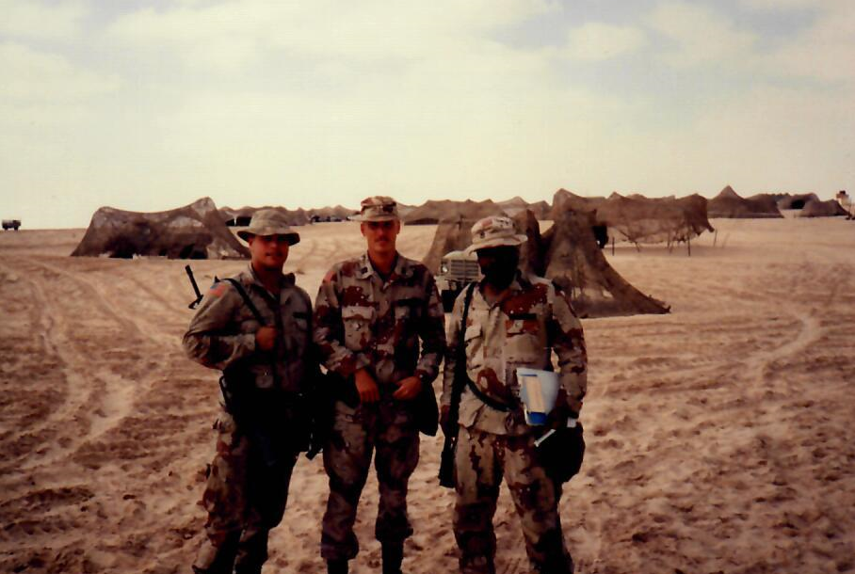
EVERYTHING resulted in waste products (regularly)
Waste products
Plastic
Tin
Aluminum
Waste oils/lubricants
Old tires
Used medical supplies
Ammunition casings/residue
Used batteries

Slide 5
Why Burn Pits?
No infrastructure to deal with trash
Guests of Saudi Arabia
Maintaining an invisible footprint for our “hosts”
Large scale littering is not an option

Slide 6
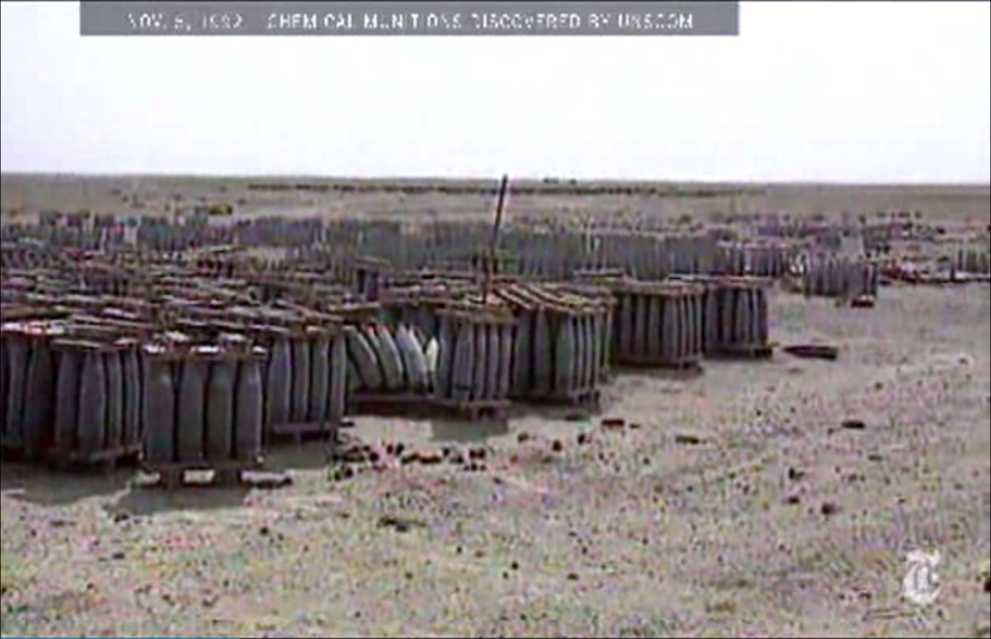
Desert Storm’s Chemical Threat
“Chemical or biological munition storage bunkers are suspected in the vicinity of Talill Air Base, Battle Positions #101, #102, #103 and near the City of Nasiriyah”
Iraq had purchased weapons from all over the world, i.e. no standardized marking system for chemical vs conventional ammunition.
Iraq had been very haphazard in their handling of chemical munitions and stored chemical and conventional munitions together.

Slide 7
The 24th Infantry Division
Plume of chemical weapons

Slide 8
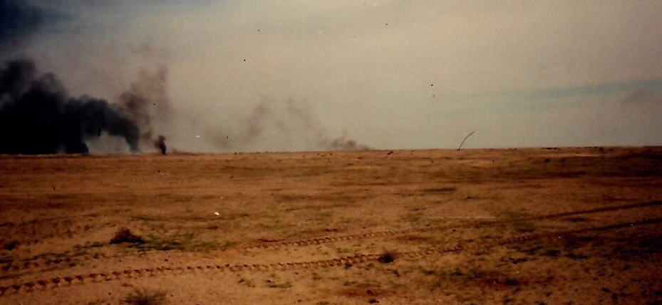
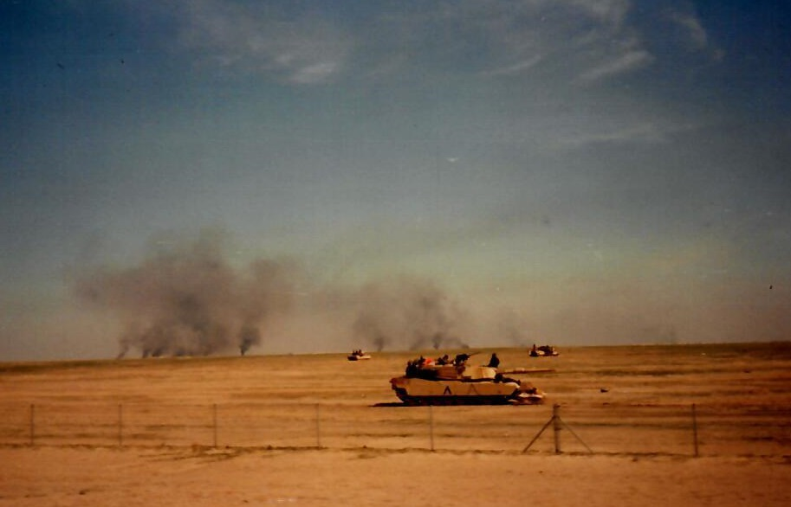
The destruction of munitions that unknowingly included Sarin and Cyclosarin gas near Khamisiyah, Iraq.

Slide 9
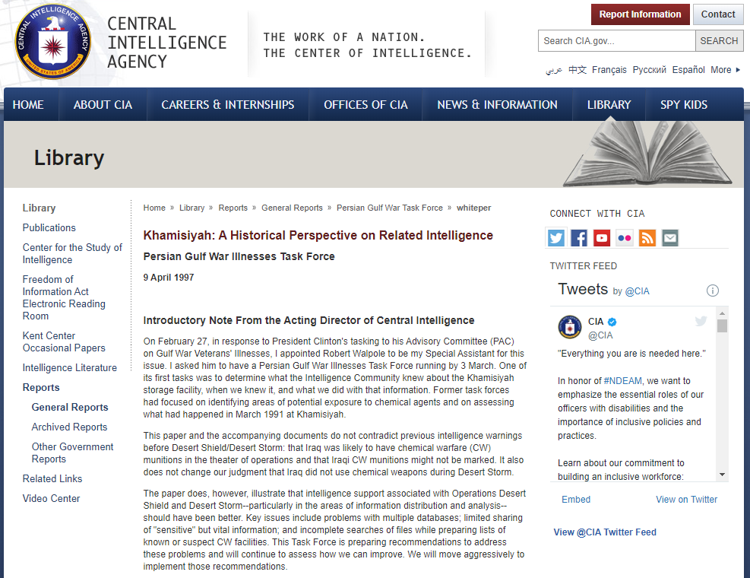

Slide 10
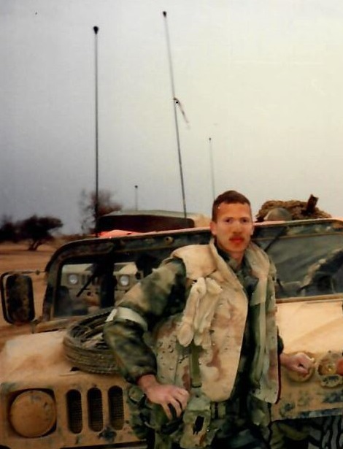
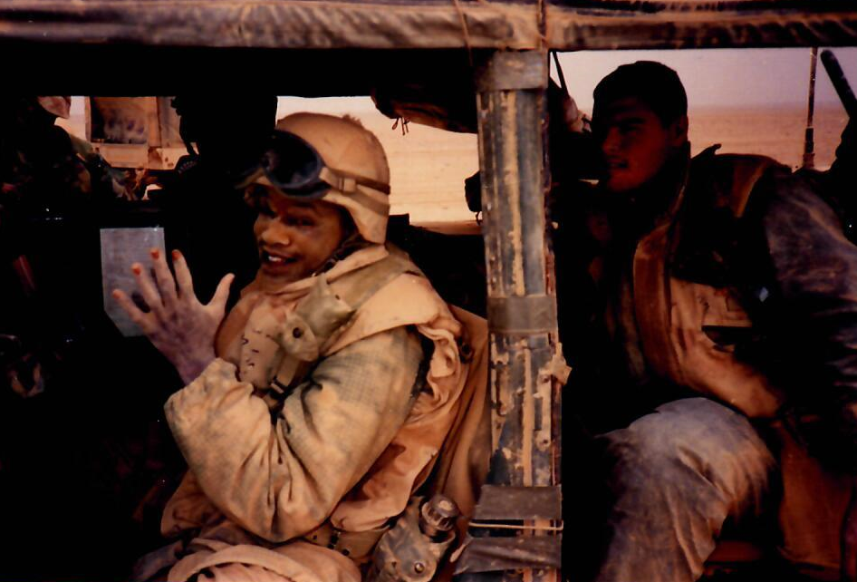
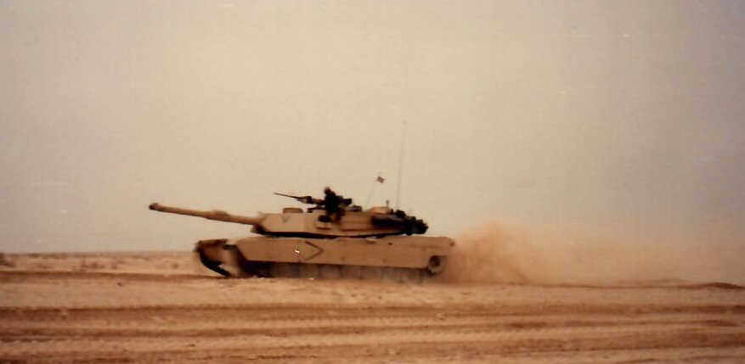
Dirt, Dust, Sand, and Charcoal

Slide 11
Depleted Uranium - Used in Military Ordnance
9 Infectious Diseases
Smoke - Oil Well Fires After The Ground War
Pyridostigmine Bromide (PB) - Prophylactic Drug for Nerve Agent
Heat Injuries
Burn Pits - Airborne Hazards and Open Burn Pits
Khamisiyah Demolition - Chemical & Biological Weapons Agents
Experimental Vaccinations - Anthrax and Botulinum Toxoid
Chem Agent Resistant Coating (CARC) - Military Vehicle Paint
Concussive Forces - Shooting, Artillery, Cannons...TBI
Diesel Fuel - Contamination Everywhere!
Noise - Gunfire, Artillery, Demolitions
Developing World (Effective) Pesticides - Zipp!
Toxic Embedded Fragments - Uranium, Tungsten, Lead, Zircon
Occupational Hazards - Lots of Dangerous Jobs
Gulf War Exposures

