Slide 1


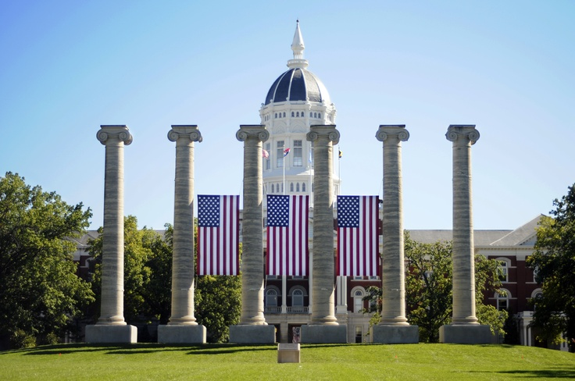
Use your own unit signatur here
(delete this text box)

Slide 2
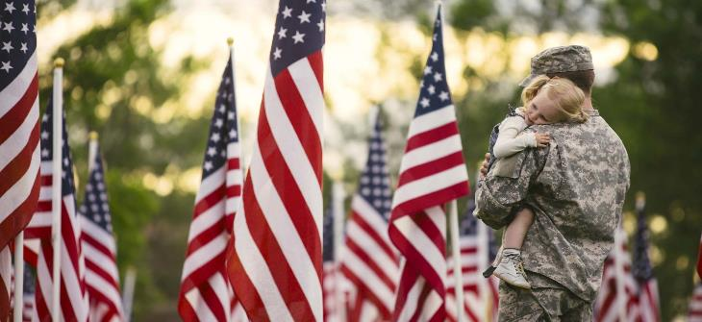

Why We Do It…
How We Do It…

Slide 3
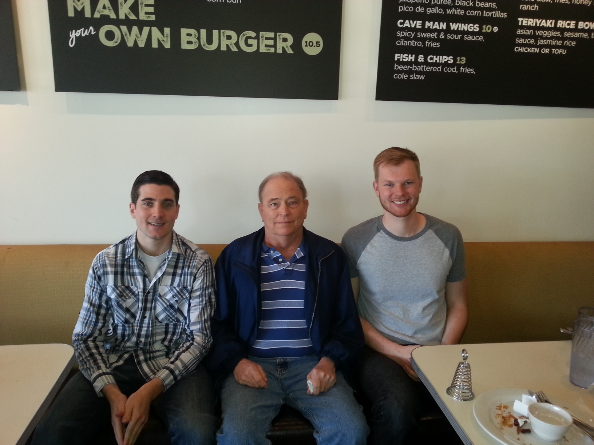
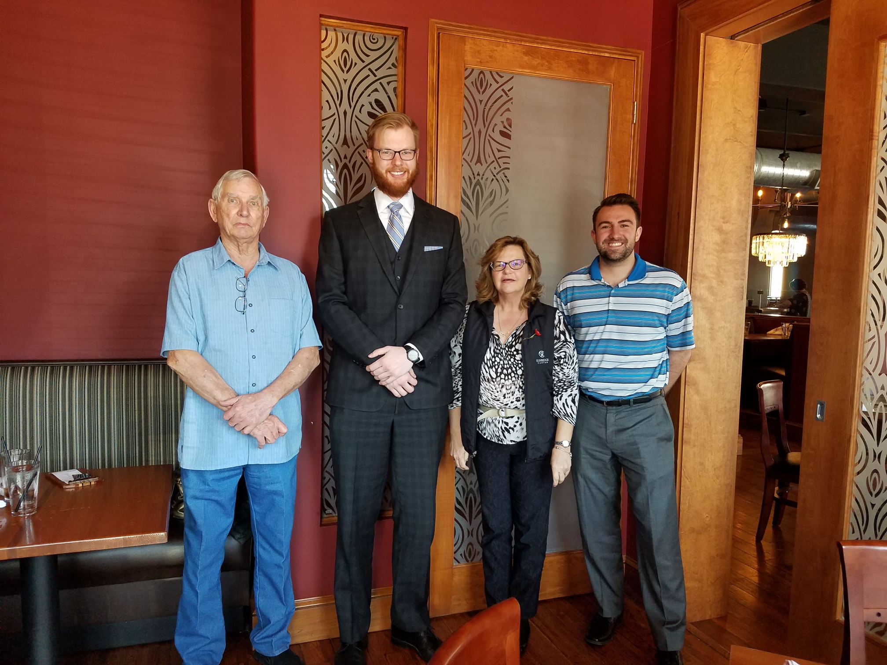
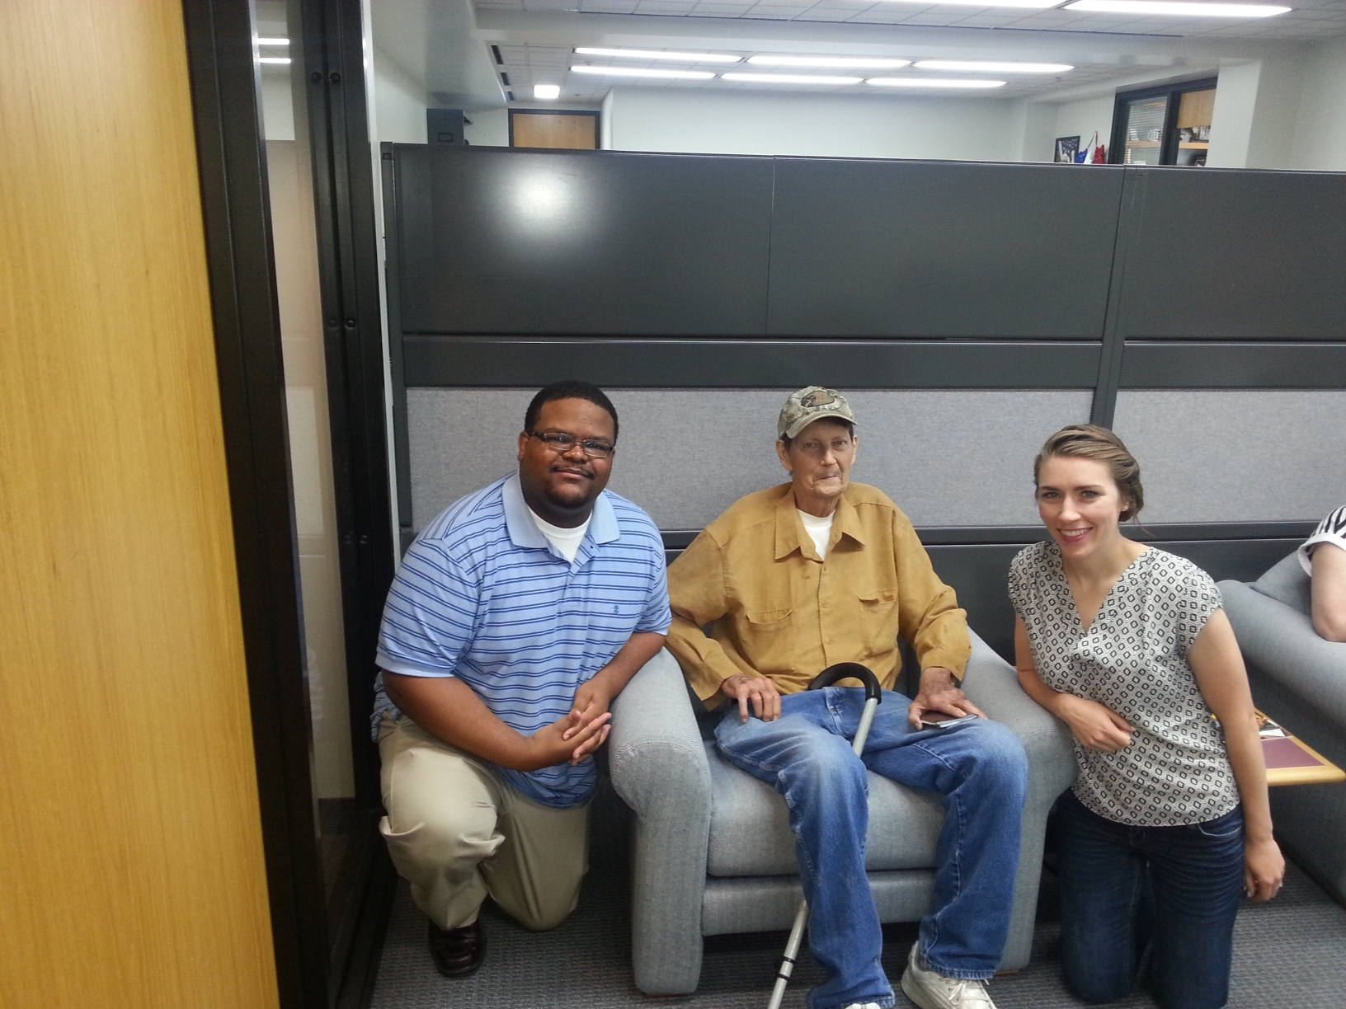
Why We Do It…

Slide 4
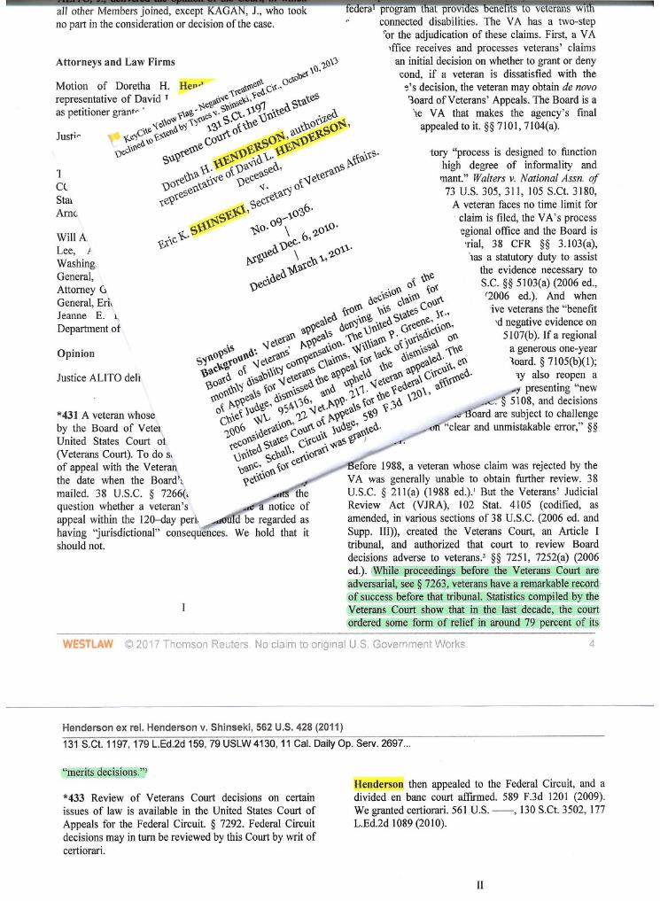
••••••••••••••••••••••••••••
Supreme Court recognizes
79%
of court cases REMANDED
due to errors.
••••••••••••••••••••••••••••
Notes:
VA error rate: 79%

Slide 5
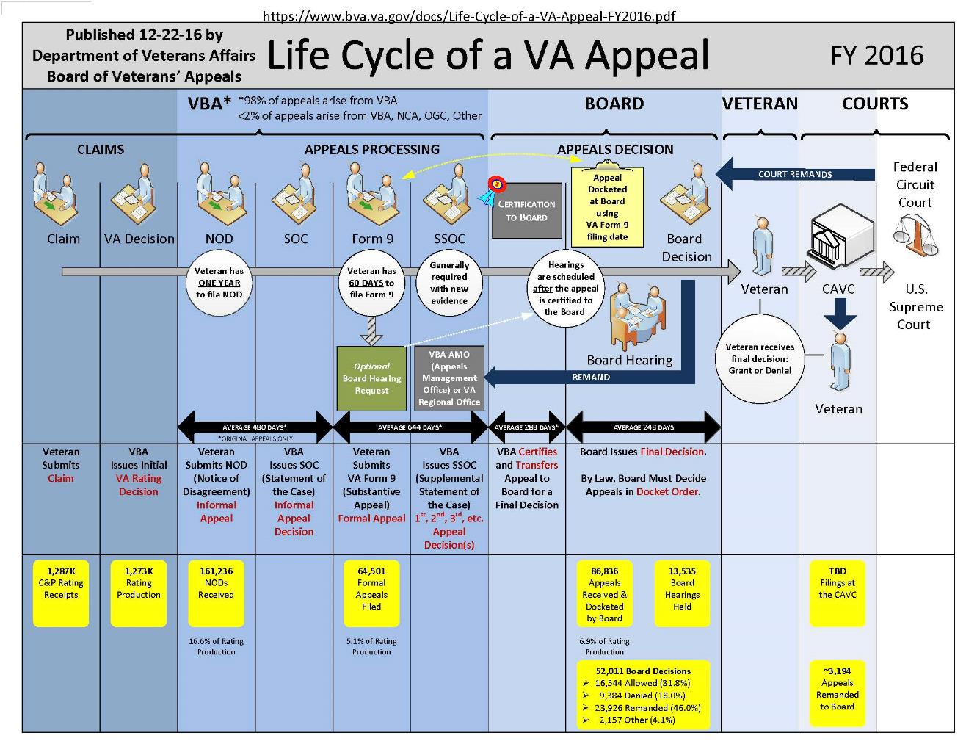
Notes:
The VA claims process is incredibly complex.
Student work is done at the Regional Office level, the Board of Veterans’ Appeals level and before the Court of Appeals for Veterans’ Claims as well as the Federal Circuit Court of Appeals.

Slide 6
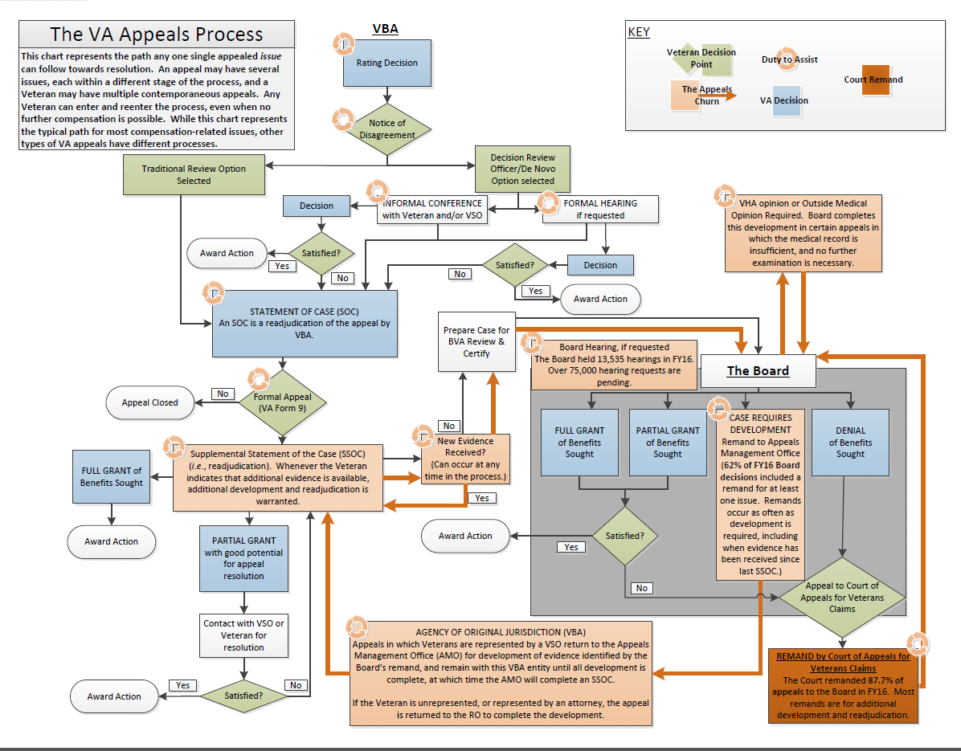
Problem: VA Appeal Process Today

Slide 7

How We Do It…
- Direct Assistance
- Symposia and Amicus
- Community Outreach

Slide 8
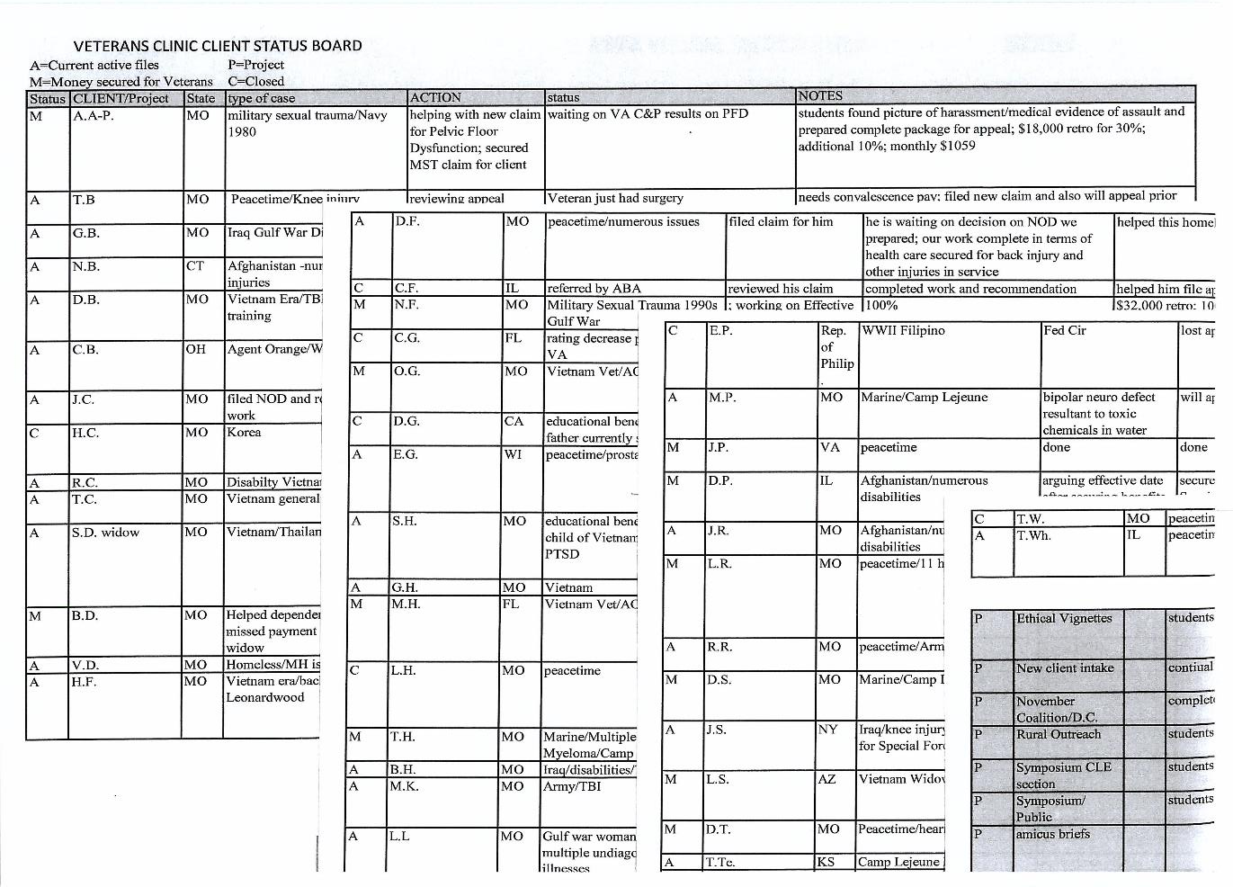
Direct Assistance
Direct Representation of More than 175 Clients

Slide 9
What we’ve done for our veterans
Secured nearly $6 million in Disability Comp for Clients
100% Success Rate in Discharge Upgrade Cases
Assisted over 600 veterans
These benefits helped countless family members

Slide 10
Amicus Briefing
Help veterans who are appealing cases to the higher courts with friend of the court briefing
Instrumental in changing the law regarding Blue Water Navy Veterans; document destruction and presumption of competency of VA examiners
Several briefs filed in the United States Supreme Court

Slide 11
Community Outreach: Tigers for Troops
73
83
21
Rural Missouri Counties Reached
Consultations
with Veterans
New Veterans Clinic Clients
19
256
9
Clients Places with Tigers for Troops Lawyers
Tigers for Troops Lawyers Trained
CLE Events in Veterans Law

Slide 12
Next Phase of Tigers for Troops
Visit new communities requesting services
Return to counties previously visited
Make TFT permanent program
Obtain long-term funding

