Slide 1
Heather B. Brown,
Strategic Partnership Officer
Randall Rogers, Ph.D.,
Local Recovery Coordinator

Slide 2
VA Eligibility

Slide 3
What is the difference between VHA and vba?
Veterans healthcare administration (VHA)
Veterans benefits administration (VBA)
VHA provides the Veteran with health care related services.
VBA provides the financial assistance a Veteran needs.
Compensation & Pension exams
Education Programs
Insurance Programs
Home Loans
Vocational Rehabilitation and Employment

Slide 4
Who we are
Truman VA is a 126-bed facility in Columbia, Missouri, that offers a full continuum of inpatient and outpatient services to Veterans from 43 counties in Missouri and one county in southwest Illinois.
We provide services to approximately 40,000 Veterans.
Services are available at Truman VA’s main campus in Columbia, or through eight Community-Based Outpatient Clinics (CBOCs).
Our Mission is to honor Veterans by optimizing their health and well-being through exceptional care, education and research.

Slide 5
Definition of a Veteran
A Veteran is a person who served in the active military, naval or air service and who was discharged or released under conditions other than dishonorable
Former Reservists may be eligible for VA health care benefits if they served full-time and for operational or support (excludes training) purposes
Former National Guard members may be eligible for care or enrollment if mobilized by a Federal order

Slide 6
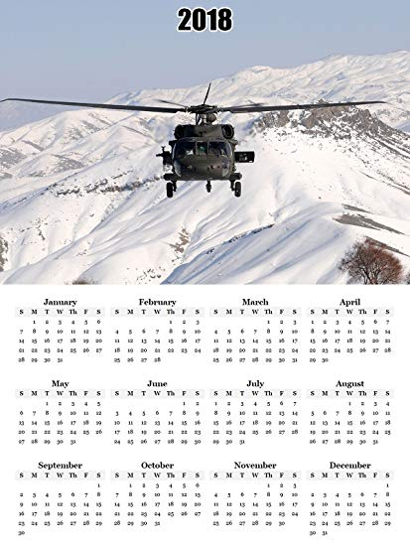
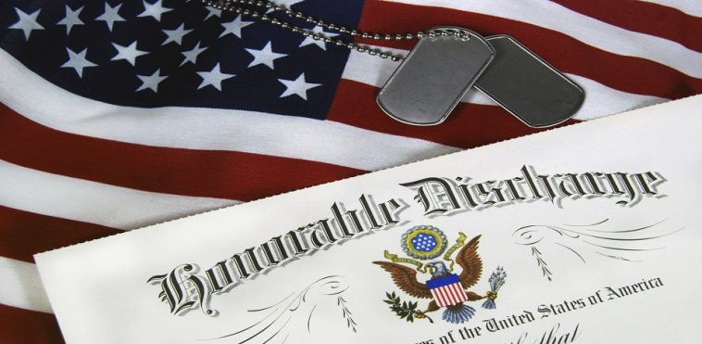
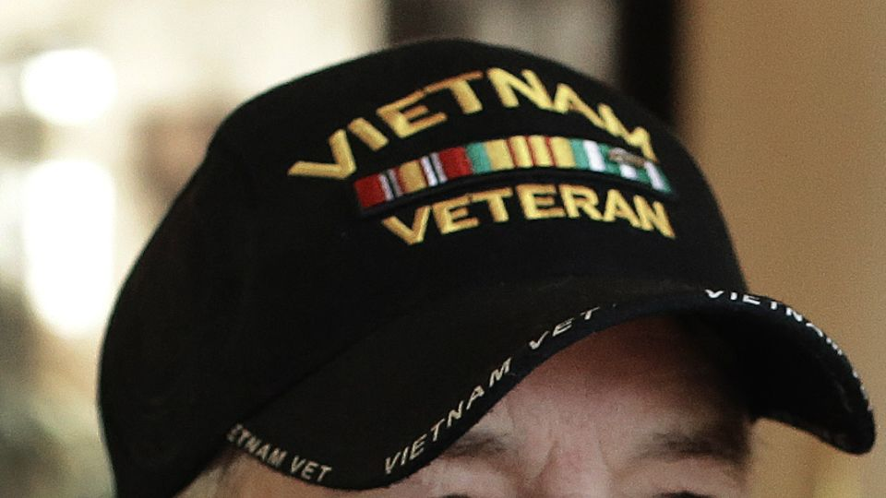
What do you need to know about eligibility?
TIME IN SERVICE
CHARACTER OF SERVICE
FINANCIAL ELIGIBILITY
SPECIALIZED ELIGIBILITY
Click icon to add picture
Click icon to add picture
Click icon to add picture
Click icon to add picture

Slide 7
Time in service Requirements
Persons enlisting in the Armed Forces after 9/7/80 (enlisted), or who entered on active duty after 10/16/81(officers), are not eligible for VHA benefits unless they completed:
24 months continuous active service,
or
the full period for which they were called or ordered to active duty
https://bit.ly/2ZYeBRf

Slide 8
Category of Discharge
Bad Conduct (BCD)
Unlike an administrative discharge, a Bad Conduct Discharge (BCD) is a punitive discharge that can only be given by a court-martial (either Special or General) as punishment to an enlisted service-member.
Dishonorable
Dishonorable discharges are handed down for what the military considers the most reprehensible conduct. This type of discharge may be rendered only by conviction at a general court-martial for serious offenses (e.g., desertion, sexual assault, murder, etc.) that call for dishonorable discharge as part of the sentence.
Honorable Through Dishonorable Discharges
Honorable*
To receive an honorable discharge, a service member must have received a rating from good to excellent for their service.
General*
service members whose performance is satisfactory but is marked by a considerable departure in duty performance and conduct expected of military members
Other Than Honorable (OTH)
An OTH is the most severe form of administrative discharge. This type of discharge represents a serious departure from the conduct and performance expected of all military members.
https://bit.ly/36EIBnM

Slide 9
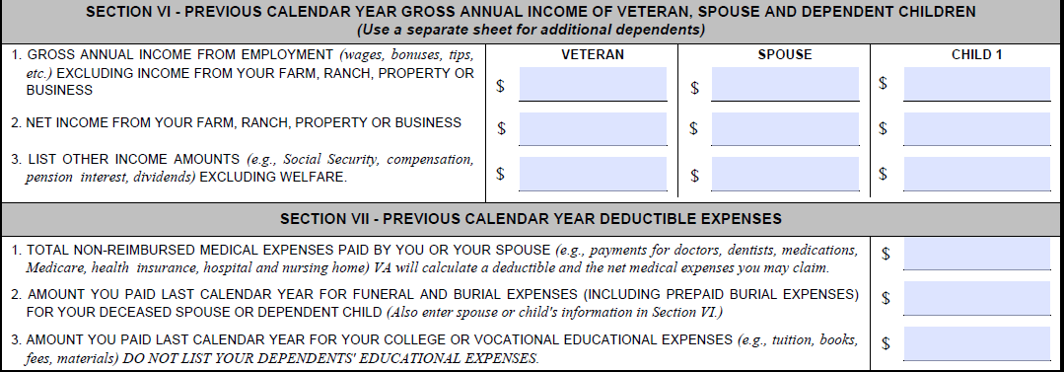
FINANCIAL ELIGIBILITY
Veterans are required to take a means test to determine if they pay medical or medication copayments. This is done once a year.
Each year, the thresholds change.
If a Veteran is over the means test threshold, have no other qualifying period of service (think special eligibility), and are not service connected, they will not be eligible for VA healthcare.

Slide 10
Special eligibility
Purple Heart
Vietnam Veteran
Camp Lejeune
Gulf War (I)
OEF/OIF/
OND

Slide 11
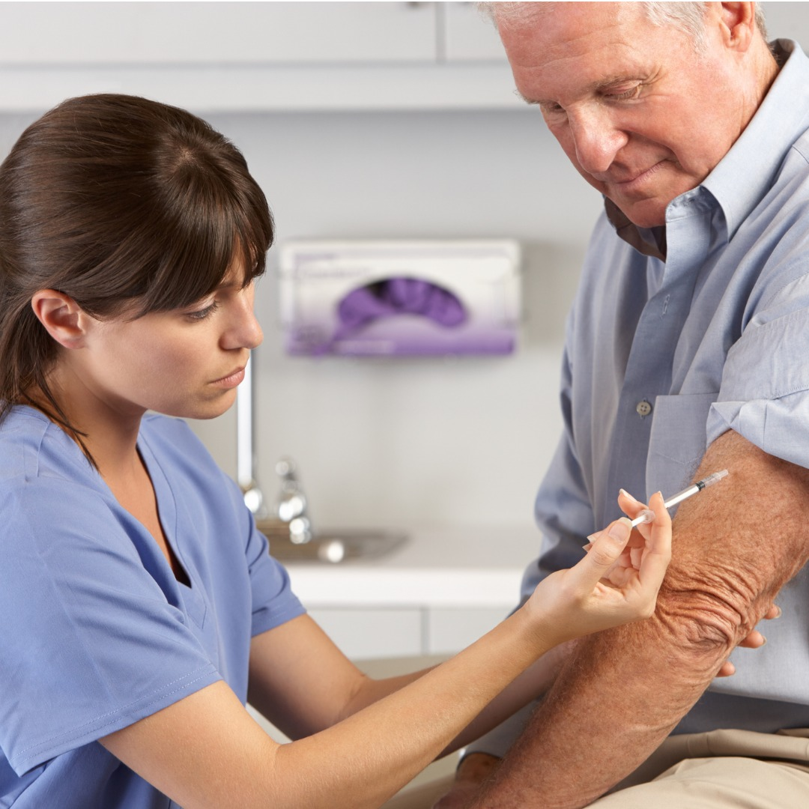
What services do we offer?
Medical benefit package
Reconstructive surgery as a result of a disease or trauma.
Hospice, palliative care, and institutional respite.
Pregnancy and delivery services
Newborn care 7 calendar days past birth
Care in the community
Preventive Care Services (i.e., primary care, whole health, etc.)
Inpatient and Outpatient Diagnostics and Treatment
Prescription Services (as prescribed by VA Physician)
Mental Health Services
Emergency Care in VA facilities
Home health services

Slide 12
What services are limited or excluded?
Limited services
excluded services
Ambulance Services
Eyeglasses and Hearing Aids
Prosthetics, Durable Medical Equipment and Rehabilitative Devices
Dental Care
VA Foreign Medical Program
Abortions and abortion counseling
In vitro fertilization (for non-service-connected Veterans)
Cosmetic surgery not medically indicated
Drugs, biologicals, and medical devices not approved by the FDA.
Gender Alterations
Membership in spas or health clubs.

Slide 13
VA Video Connect

Slide 14
One way to use technology to reach Veterans who have barriers to making a face-to-face visit.
Came from telemedicine, which the VA has been doing for several years.
Veterans can use any device that has a screen, camera, and microphone.
Veterans receive an email with a link that automatically opens the program.

Slide 15
VA Video Connect

Slide 16
VA Video Connect

Slide 17
Growth of Veteran seen with vvc

Slide 18
Growth of Veteran seen with vvc

Slide 19
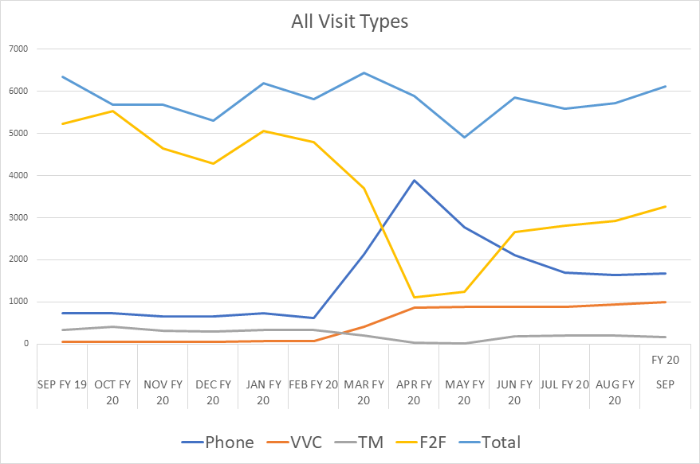
ALL VISIT TYPES ACROSS TIME

Slide 20
100% of Behavioral Health staff have completed at least one VVC visit in the past year.
VVC use continues to rise, in terms of both completed visits and Veterans served, even though we are increasing the number of face-to-face visits.

Slide 21
Cognitive Biases

Slide 22
These are a universal feature of human cognition. They are essentially “system errors” of the brain.
They are reliable.
All of us have them.
Strongly influence by environmental factors such as, for example, how information is presented.

Slide 23
Thinking, Fast and Slow: System errors for the brain

Slide 24
Cognitive Biases
Would you believe….
Seeing random, irrelevant numbers affects subsequent estimations you make?
Stating a probability in terms of a gain or loss affects your behavior.
We give losses more “weight” than we give gains. The loss of a certain magnitude feels bad to a greater extent than a gain of the same magnitude feels good.
We think that things that come to mind more readily are actually more common.
We can’t think statistically.

Slide 25
FRAMING & LOSS AVERSION
AVAILABILITY BIAS
CERTAINTY OVER DOUBT
* CHOICE* ARCHITECTURE
ANCHORING
EXTENT TO WHICH WE MAKE STORIES OUT OF CORRELATIONS
The way that information is presented affects our decisions
We rely heavily on the first piece of information introduced when making decisions
We often draw different conclusions from the same information, depending on how it’s presented
WE RELY ON IMMEDIATE EXAMPLES THAT COME TO MIND WHILE MAKING JUDGEMENTS

Slide 26
Biases in Health Care
Literature review from 2015.
213 studies included.
192 studies confirmed the presence of a bias.
73 studies assessed decision making by medical personnel.
80% of studies examining medical personnel confirmed the presence of a cognitive bias, and 61% of studies examining patients confirmed the presence of a cognitive bias.
J. S., Blumenthal-Barby and Heather Krieger (2015). Cognitive biases and heuristics in medical decision making: A critical review using a systematic search strategy. Medical Decision-Making

Slide 27
Biases in Diagnoses
Literature review from 2016
At least one bias was found to have a role in all 22 studies reviewed.
50% to 100% of physicians were affected by at least one cognitive bias.
Most commonly studied biases were framing and overconfidence.
Gustavo Saposnik, Donald Redelmeier, Christian Ruff, Philippe Tobler (2016). Cognitive Biases associated with medical decisions: a systematic review. BMC Medical Informatics and Decision Making.

Slide 28
Diagnostic Errors
Errors are costly and affect millions of people. Diagnoses-related errors are a substantial cause of malpractice claims.
Generally are not the result of faulty knowledge or faulty data gathering. More common causes of errors are cognitive and systems errors.

Slide 29
Training in Cognitive Biases
This type of training is uncommon.
Increased interest in recent years.
“Cognitive Autopsy” is an approach developed by Croskerry, one of the leading researchers in this area.
Truman VA is in the process of developing this kind of training.
A secondary benefit we want to emphasize is an appreciation that we are all fallible and therefore need support.

Slide 30
My life my story

Slide 31
It’s far more important to know what person the disease has than what disease the person has. – Hippocrates 400 BCE
Notes:
"I would like to thank you for the “My Story” you did on a Veteran I saw in clinic today with one of the Duke endocrine fellows. When we reviewed the medical part of the record, he was “a 61M h/o DM (prev glipizide, A1c 11.9 10/27, now on insulin) without known complication, PTSD/MDD, chronic pain on methadone, OSA s/p UPPP on CPAP, recent hospitalization for empyema” presenting for ongoing management of his diabetes.
After we read the “My Story”, he became a hero in our eyes. Turns out he was in the 82nd airborne division as a machine gunner. He joined the Army boxing team and spent a year as a novice boxer, winning a tournament and training for the 1976 Olympics. He was a cook in Afghanistan and with only 11 helpers, he cooked for 11,000 soldiers! He still cooks for his wife. He now helps other Veterans by taking care of their spiritual needs as a pastor.
It was wonderful to have this background on the Veteran before we saw him in clinic. The fellow commented that she would love to read a “My Story” on all the patients we see. Knowing he is a cook, we could tailor our diet education to meet his needs. Knowing that he had been active in sports helped us counsel him on the importance of physical activity in managing diabetes."

Slide 32
What is my life my story?
The Program
The Process
The Stories
Pilot program launched at the Madison VA Medical Center in 2013
It has been implemented at 24 VA Medical Centers
As of 2017, over 2,600 Veterans have been interviewed.
Staff, volunteers or student learners interview the Veterans
The interviewer writes up the story and reviews/edits it with the Veteran
Veterans get printed copies of the approved story to share with family and/or friends.
The story is added to CPRS (VA’s medical record) as a “My Story” note.
1,000 word
First-person narrative
Told in the Veteran’s voice
Reviewed and approved by the Veteran
Placed in the Veterans Medical File

Slide 33
Stories change the culture
2014
Notes:
"I would like to thank you for the “My Story” you did on a Veteran I saw in clinic today with one of the Duke endocrine fellows. When we reviewed the medical part of the record, he was “a 61M h/o DM (prev glipizide, A1c 11.9 10/27, now on insulin) without known complication, PTSD/MDD, chronic pain on methadone, OSA s/p UPPP on CPAP, recent hospitalization for empyema” presenting for ongoing management of his diabetes.
After we read the “My Story”, he became a hero in our eyes. Turns out he was in the 82nd airborne division as a machine gunner. He joined the Army boxing team and spent a year as a novice boxer, winning a tournament and training for the 1976 Olympics. He was a cook in Afghanistan and with only 11 helpers, he cooked for 11,000 soldiers! He still cooks for his wife. He now helps other Veterans by taking care of their spiritual needs as a pastor.
It was wonderful to have this background on the Veteran before we saw him in clinic. The fellow commented that she would love to read a “My Story” on all the patients we see. Knowing he is a cook, we could tailor our diet education to meet his needs. Knowing that he had been active in sports helped us counsel him on the importance of physical activity in managing diabetes."

Slide 34
Stories change the culture
2017

Slide 35
Why these stories matter
My patient went from being a “61M h/o DM without known complication, PTSD/MDD, chronic pain on methadone” who presented for ongoing management of diabetes…

Slide 36
Why these stories matter
To a hero. He was a machine gunner in the 82nd airborne, who joined the Army boxing team and spent years as a novice boxer who trained for the 1976 Olympics. He was also a cook for over 11,000 soldiers while in Afghanistan. He now helps other Veterans by taking care of their spiritual needs as a pastor.

Slide 37
The future
VVC, Cognitive Biases training and the My Life My Story are two innovative programs that advance the patient and provider experience.
VA shift from traditional medicine model to whole health and patient experience can only benefit all involved.

Slide 38
Questions?
Heather.brown5@va.gov
(573)814-6393
Or
RANDALL.ROGERS2@va.gov
(573)814-6278
www.columbiamo.va.gov
@VAColumbiaMO
@Columbiamova
@VAColumbiaMO

