Slide 1
Bart Stichman, NVLSP
Forcing Systematic Change for Veterans Through Innovative Advocacy: Class Actions and Beyond

Slide 2
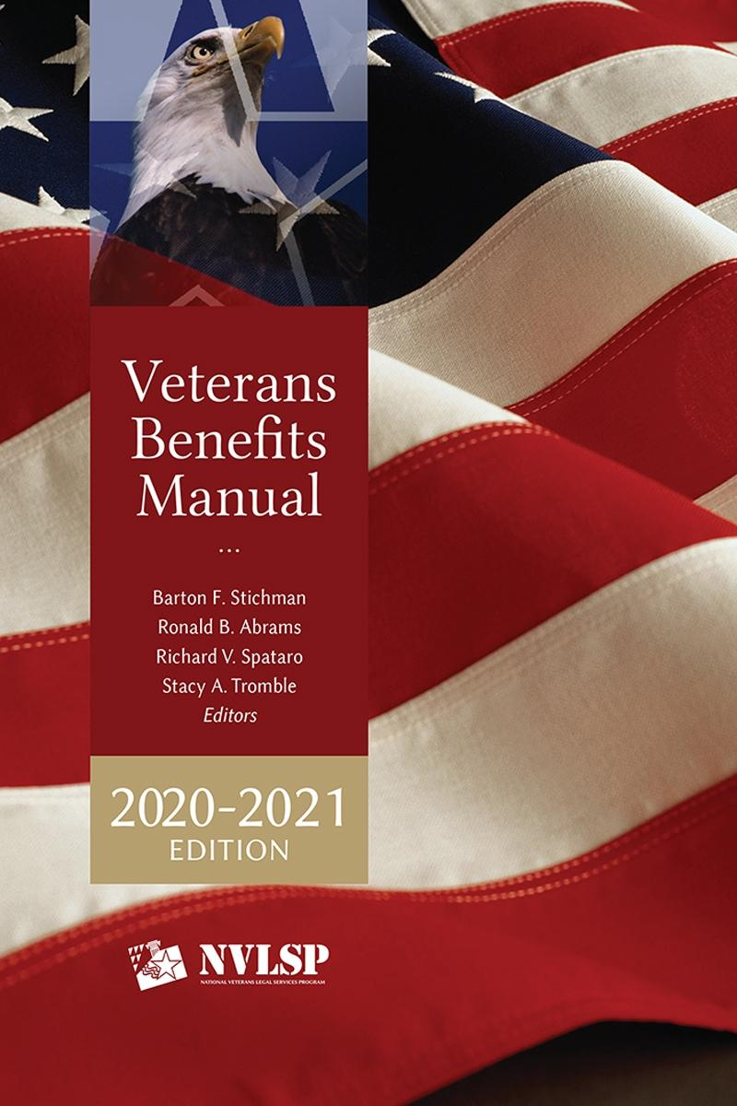
National Veterans Legal Services Program
Co-founded NVLSP and served as the Executive Director for more than 40 years
Currently serving as Special Counsel, focusing on NVLSP’s litigation activities
Always fighting to create a more transparent system to help veterans and their families
Symposium 2021: Pushing the Envelope – First in Advocacy for America’s Heroes

Slide 3
1980- DISCHARGE UPGRADES
Litigated landmark cases: Giles v. Secretary of the Army and Wood v. Secretary of Defense
Resulting in precedent setting decisions and upgrades in discharges for over 7,000 Vietnam veterans

Slide 4
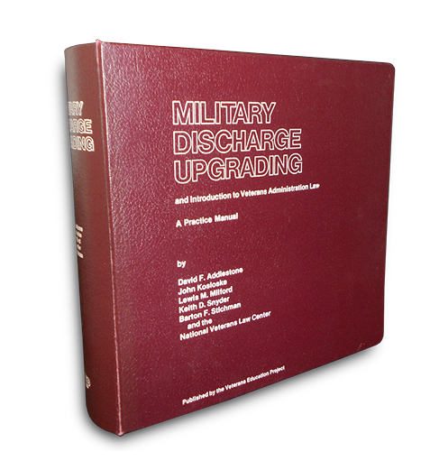
1980- MILITARY DISCHARGE UPGRADE MANUAL
NVLSP predecessor publishes the Military Discharge Upgrade Manual, the nation’s first treatise for advocates representing veterans seeking an upgrade of a less than honorable discharge

Slide 5
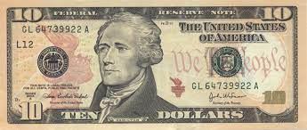
REPEALING TWO KEY LAWS
First law repealed→ Depression-era law that barred veterans from appealing a VA denial of benefits to federal courts
Second law repealed→ $10 lawyer fee cap on representing veterans before the VA
This 1862 law made it a federal crime for a lawyer to charge a veteran a fee of more than $10 to represent the veteran in a VA claim

Slide 6
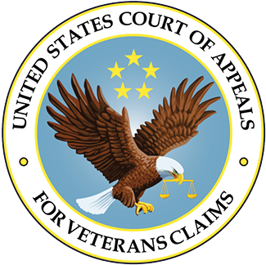
1988- U.S. COURT OF APPEALS FOR VETERANS CLAIMS
Congress repeals the long-standing ban on court review of VA decision-making and creates the U.S. Court of Appeals for Veterans Claims (CAVC) to review VA decisions denying benefits

Slide 7
1989- NEHMER V. U.S. VETERANS ADMINISTRATION
Court invalidates VA regulations requiring the denial of claims for disability and death benefits filed by Vietnam Veterans and their families for diseases associated with exposure to Agent Orange
Since 1991, the Nehmer consent decree has resulted in payment of more than $4.6 billion in retroactive payments to more than 100,000 Vietnam veterans and their survivors

Slide 8
1991- VETERANS BENEFITS MANUAL
NVLSP publishes The Veterans Benefits Manual starting in 1991
Designed to help increase the pool of effective veteran advocates to assist veterans seeking VA benefits
Ever since 1999, NVLSP has published a new addition of the Manual each year

Slide 9
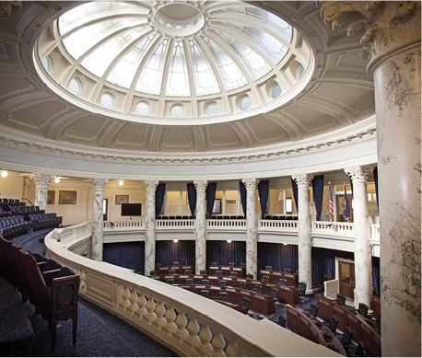
1992- VETERANS CONSORTIUM PRO BONO PROGRAM
Congress begins funding the Veterans Consortium Pro Bono Program (established by NVLSP with three other VSO’s) to recruit, train, and mentor private bar attorneys to provide free representation to veterans who appeal to the U.S. Court of Appeals for Veterans Claims without a legal representative
Congressional funding of this program continues to this day

Slide 10
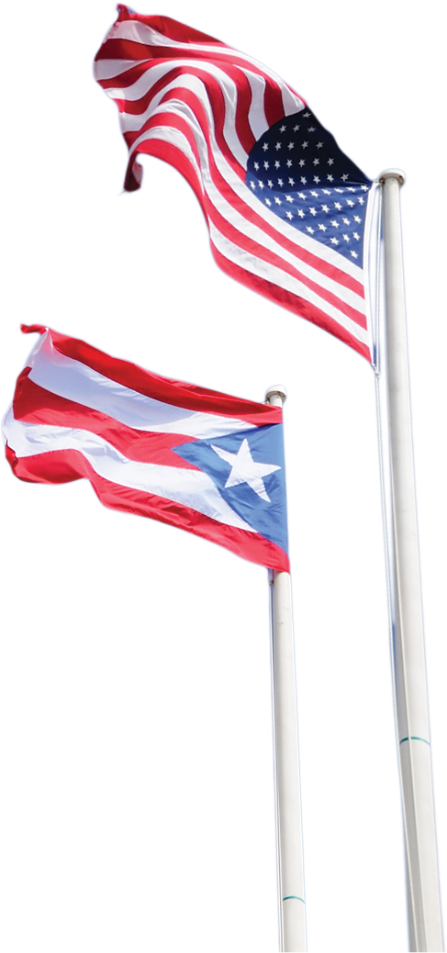
1993- GIUSTI-BRAVO v. VA
In a class action lawsuit, NVLSP forces the VA to pay more than $60 million in retroactive compensation and tens of millions of dollars in prospective compensation to more than 600 Puerto Rican veterans who suffered reduced benefits arising from their total 100% disability ratings as a result of VA’s application of illegal rules

Slide 11
2004- GUTIERREZ V. PRINCIPI
NVLSP has filed over 5,000 appeals with the CAVC, resulting in many important legal precedents, including Gutierrez v. Principi
Gutierrez establishes that veterans of the Persian Gulf and Iraq wars need not prove that “undiagnosed illnesses” are connected to military service for these illnesses to qualify for VA disability compensation

Slide 12
2007- LAWYERS SERVING WARRIORS
NVLSP launches the national pro bono program, Lawyers Serving Warriors
NVLSP has screened the claims of up to 400 veterans each year, placing them with private law firms and corporate legal departments for representation at no cost to veterans

Slide 13
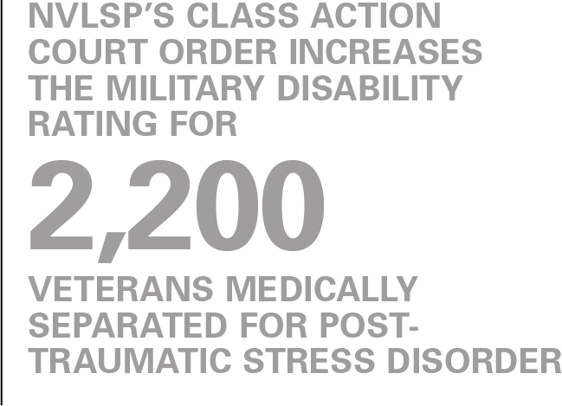
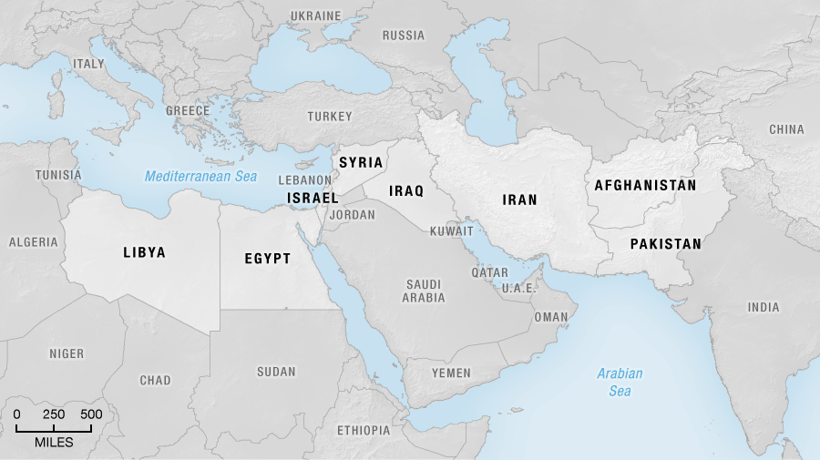
2011- SABO V. UNITED STATES
NVLSP obtains a class action court order requiring an increase in military disability rating assigned to more than 2,200 veterans who served in Iraq or Afghanistan and were medically separated for PTSD without the military disability benefits to which they were lawfully entitled

Slide 14
2014- COMBAT-INJURED VETERANS TAX FAIRNESS ACT OF 2016
NVLSP successfully lobbies Congress to enact the “Combat-Injured Veterans Tax Fairness Act of 2016,” providing eligible veterans the right to seek a refund of taxes they may have paid on their Disability Severance Pay

Slide 15
2016- STAAB V. SHULKIN
NVLSP convinces the U.S. Court of Appeals for Veterans Claims to strike down - as contrary to statute - the VA regulation denying reimbursements to veterans for any part of the emergency medical expenses they incur at a non-VA facility simply because the veteran has health insurance that covers part of the expenses incurred. Staab v. Shulkin

Slide 16
2018- WOLFE V. WILKIE
Despite NVLSP’s court victory in Staab v. Shulkin case, VA implements an illegal rule relating to reimbursement of emergency bills
NVLSP files a class action, Wolfe v. Wilkie, challenging the VA’s 2018 rule
The CAVC certifies the case as a class action, invalidates the VA’s 2018 rule, and orders VA to re-adjudicate the reimbursement claims of 75,000 class members

Slide 17
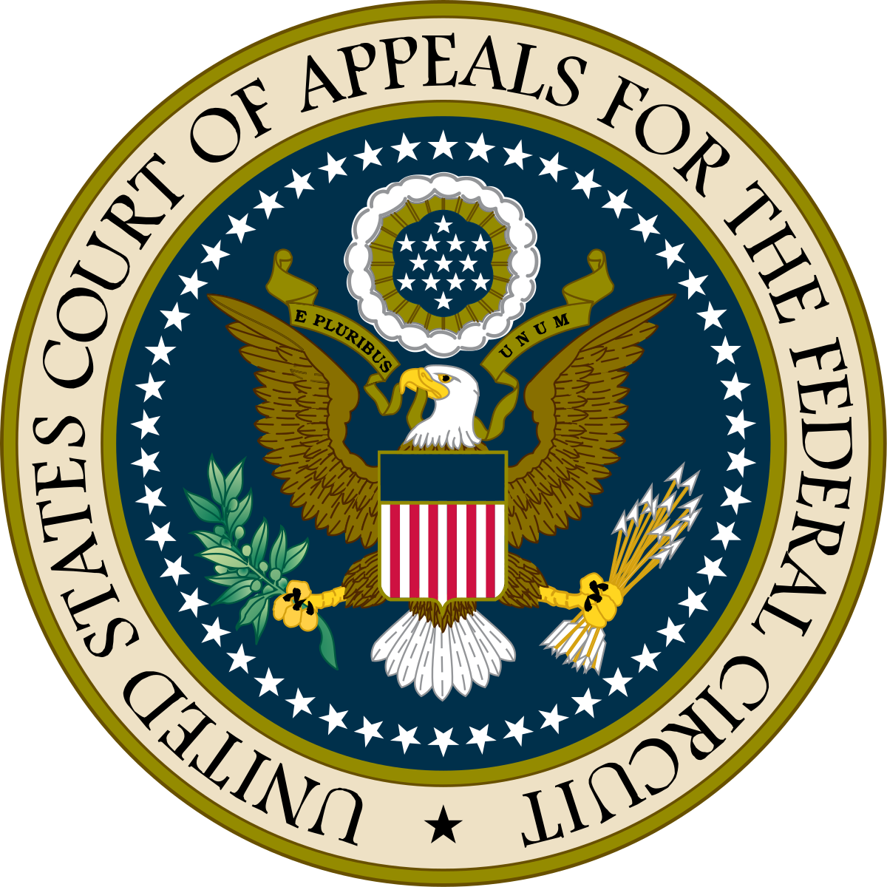
2018- OVERTURNING PRECEDENT
NVLSP persuades the Court of Appeals for the Federal Circuit to overturn a 19-year-old lower court precedent that prohibited VA from awarding disability benefits to a veteran for disabling pain related to military service if the pain is not linked to a medical diagnosis

Slide 18
2019- GODSEY V. WILKIE
In 2019, NVLSP convinced the Veterans Court to certify its first class action.
In Godsey v. Wilkie, the Veterans Court certified a class of thousands of VA benefits claimants whose appeals to the Board of Veterans’ Appeals were delayed for years at the VA’s regional offices without moving their appeals forward to the Board
The Veterans Court ruled that the VA delays were unreasonable and ordered the VA to transfer the appeals of all class members to the Board within 120 days

Slide 19
2020- NEHMER CONSENT DECREE
November 5, 2020- U.S. District Court grants the motion filed by NVLSP to enforce the part of the 1991 class action consent decree in Nehmer, requiring VA to presume that the Navy Veterans who served in the territorial seas of Vietnam and their survivors were exposed to Agent Orange
VA identified over 60,000 Navy Vietnam veterans and their survivors whose cases the VA must automatically review to determine if these individuals served in the territorial seas and, if so, whether they are entitled to compensation for their Agent Orange-related diseases under the Nehmer Consent Decree

Slide 20
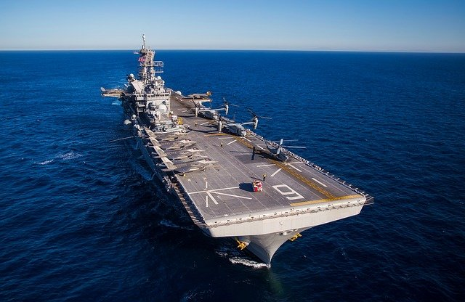
2020- CLASS ACTION ON BEHALF OF FORMER SAILORS AND MARINES
November 10, 2020- NVLSP filed a class action complaint in U.S. District Court on behalf of former members of the Navy and Marine Corps who were subject to an unlawful Navy practice that resulted in the denial of lifetime military disability retirement benefits to more than 16,000 Navy and Marine Corps veterans

Slide 21
WEBINARS
NVLSP webinar programs have trained more than 4,000 veterans service officers, attorneys, and claims agents
Topics have included, for example, advocacy strategies for service-connected disability claims based on military sexual trauma, disability pension, combat-related special compensation, common VA errors, and court updates

Slide 22
NVLSP
Individual Representation
Lawyers Serving Warriors
Class Actions
Training and Mentorship
Free legal representation to veterans and active duty personnel through national network of law firms and corporate legal departments
Help veterans for free in their battle to secure proper disability benefits
Recruits, trains and mentors both lawyer and non-lawyer advocates to help veterans secure their hard-earned benefits
Publications
Publication of advocacy materials to increase pool of advocates available to help as well as empower advocates in the effective representation of their clients

