Slide 1
The wrong stuff
Advocating for accuracy at the federal circuit level
Mel Bostwick
October 29, 2021

Slide 2
Why is there so much “wrong stuff”?
Administrative burden
Legal and factual complexity
Absence of advocates

Slide 3
Who can fix it?
United States Supreme Court
Board of Veterans’ Appeals
RO
RO
RO
RO
Petition for certiorari
38 U.S.C. § 7292
38 U.S.C. § 7261
U.S. Court of Appeals for the Federal Circuit
Plenary review
U.S. Court of Appeals for Veterans’ Claims
Claims, supplemental claims, and higher-level review

Slide 4
U.S. Court of Appeals for the Federal Circuit
Chief Judge Kimberly Moore
Haldane Mayer
U.S. Military Academy,
U.S. Army Infantry, Army JAG Corps, Army Reserve
S. Jay Plager
U.S. Navy
Alan David Lourie
Pauline Newman
Raymond Clevenger
Alvin A. Schall
William C. Bryson
Richard Linn
Timothy B. Dyk
Sharon Prost
Kathleen O’Malley
Jimmie Reyna
Evan Wallach
U.S. Army, Judge Advocate of the Army, Nevada National Guard Judge Advocate
Richard Taranto
Raymond Chen
Todd M. Hughes
U.S. DOJ, Commercial Litigation
Kara Stoll
Tiffany Cunningham

Slide 5
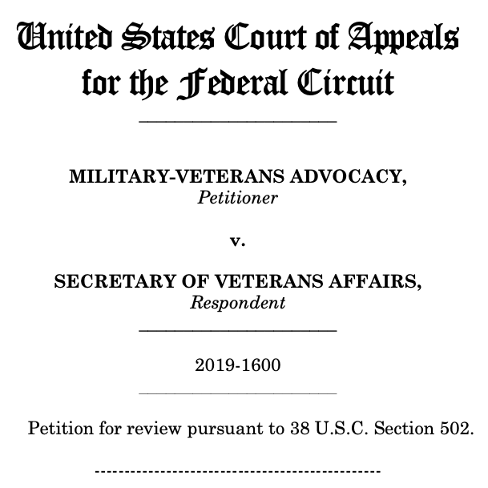
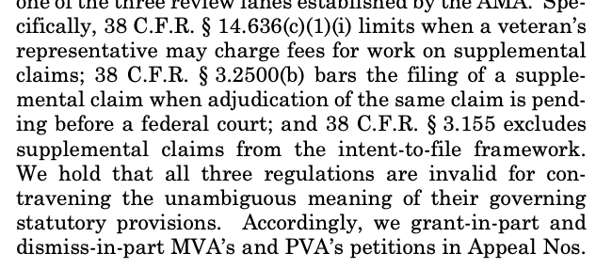
Making your case
Preemptive challenges

Slide 6
Making your case
Preemptive challenges
38 U.S.C. § 502
Six years—not sixty days
Establish standing
The APA is your friend

Slide 7
Making your case
Individual appeals
“The Court of Appeals for the Federal Circuit…”
“shall decide all relevant questions of law” but “may not review (A) a challenge to a factual determination, or (B) a challenge to a law or regulation as applied to the facts of a particular case”*
Expect a jurisdictional objection
* “[e]xcept to the extent that an appeal under this chapter presents a constitutional issue”
As-applied constitutional challenges are allowed (and being reviewed in Taylor)
“shall hold unlawful and set aside any regulation or any interpretation thereof . . . that was relied upon in the decision of the Court of Appeals for Veterans Claims”
Watch for preservation of issues (and harmless error)
“arbitrary and capricious,” “contrary to constitutional right,” “in excess of statutory jurisdiction,” “in violation of a statutory right,” or “without observance of procedure required by law”
Don’t let your argument get lost in this mess of jargon—and think about the pro-veterans canon
38 U.S.C. § 7292(d)

Slide 8
Making your case
Individual appeals
Present impairment
Disability
Nexus
Resulting from
Incurrence
Personal injury suffered or disease contracted in line of duty
38 U.S.C. § 1110

Slide 9
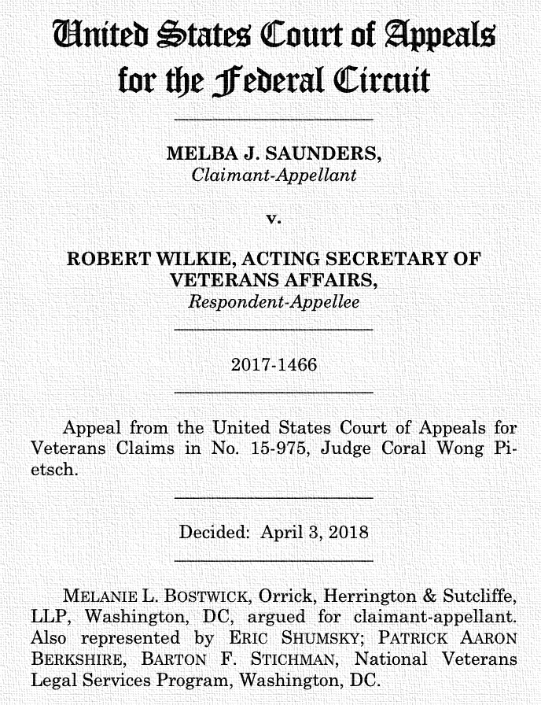
Making your case
Individual appeals
Disability = functional impairment
Functional impairment includes pain
Cited in 13,410 Board decisions to date

Slide 10
Making your case
En banc review

Slide 11
Making your case
En banc review
Procopio v. Wilkie
Interpretation of presumptive service-connection statute for Blue Water Navy Vietnam Veterans (9-2 pro-veteran)
Francway v. Wilkie
En banc footnote (12-0) converting “presumption of competency” into…something?
NOVA v. Secretary
Standing, timing, and scope of rulemaking challenges (11-0)
Arellano v. McDonough
Equitable tolling of effective date of disability claim (6-6)
Taylor v. McDonough
Equitable estoppel/ constitutional right of access for effective date (argument TBD)

Slide 12
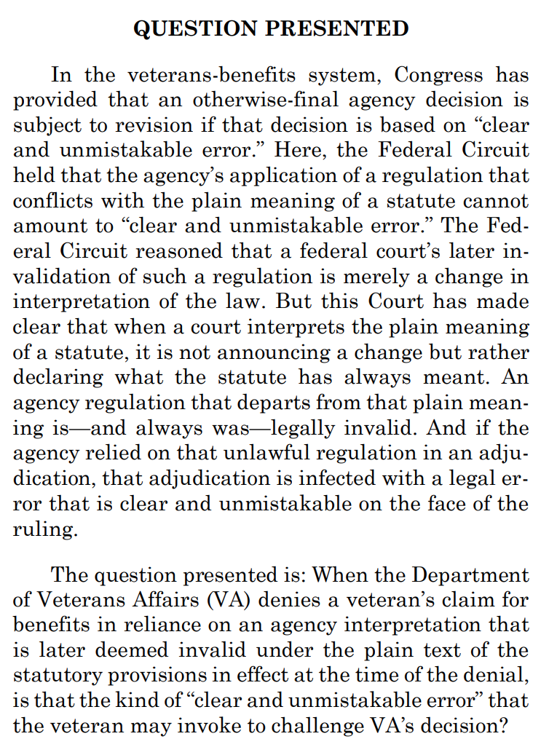
Making your case
Supreme Court review

Slide 13
Making your case
Supreme Court review
Crystallize your issue
Tell them why it matters
Look beyond the veterans’ context
Intra-circuit “split”

Slide 14
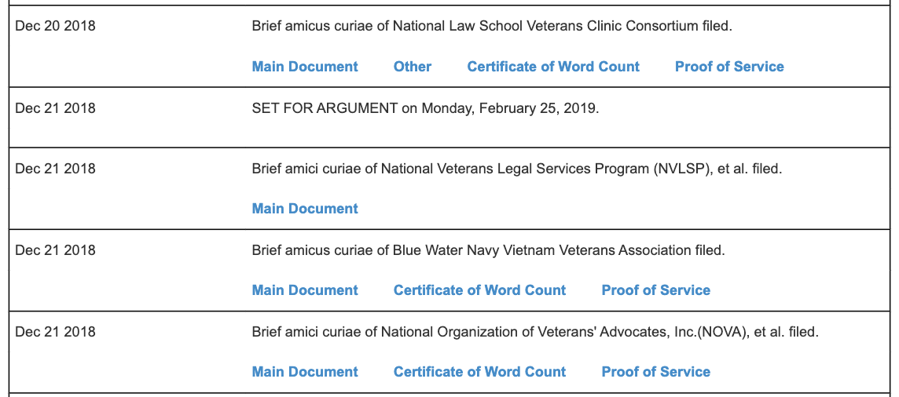
Making your case
With a little help from your friends

Slide 15
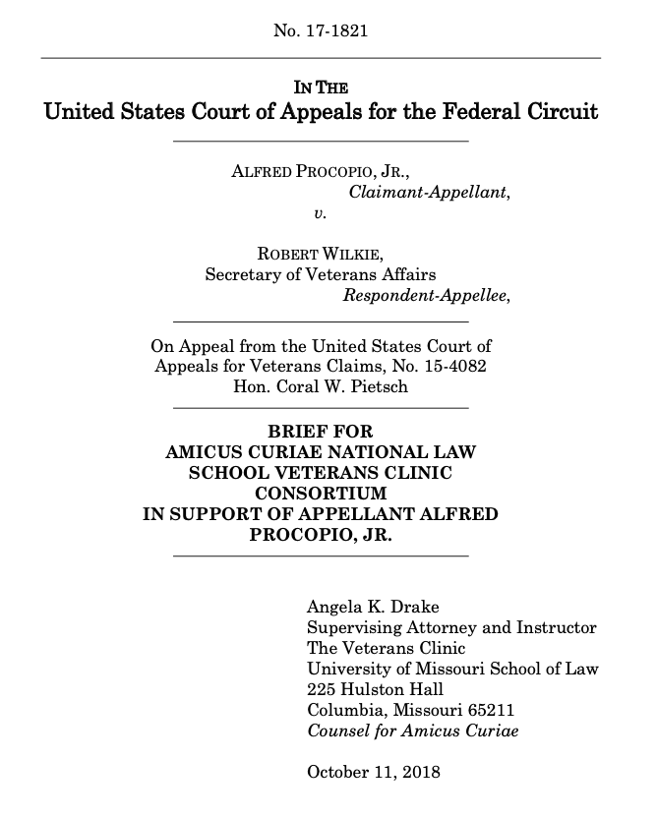
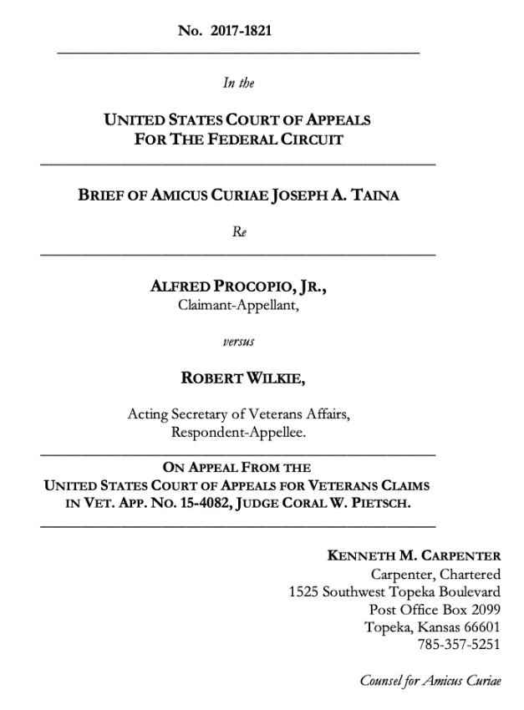
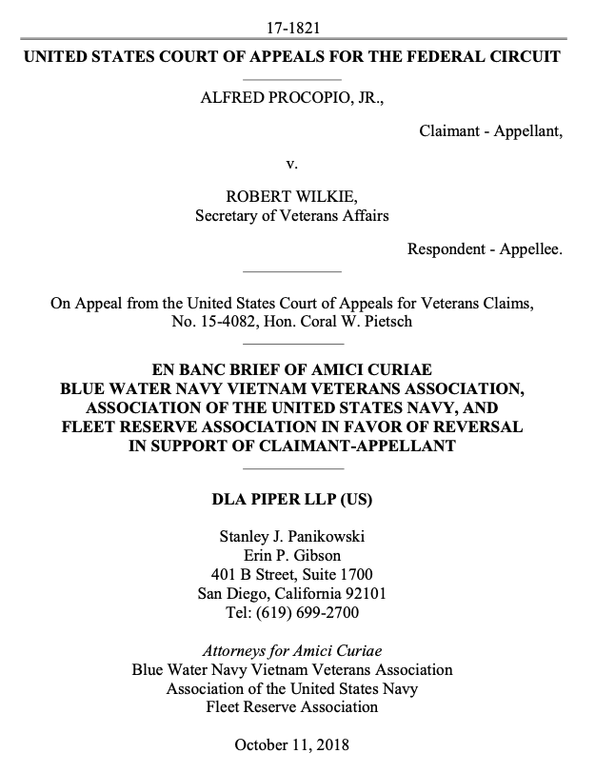
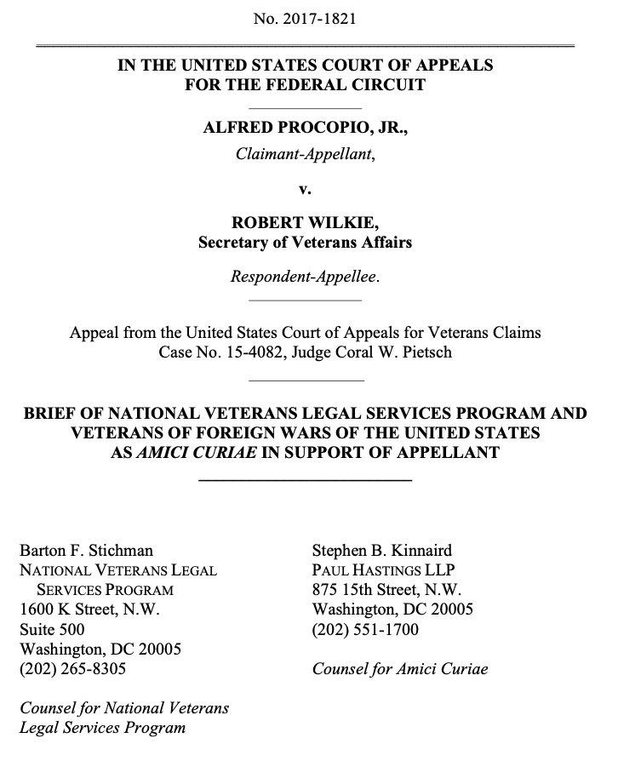
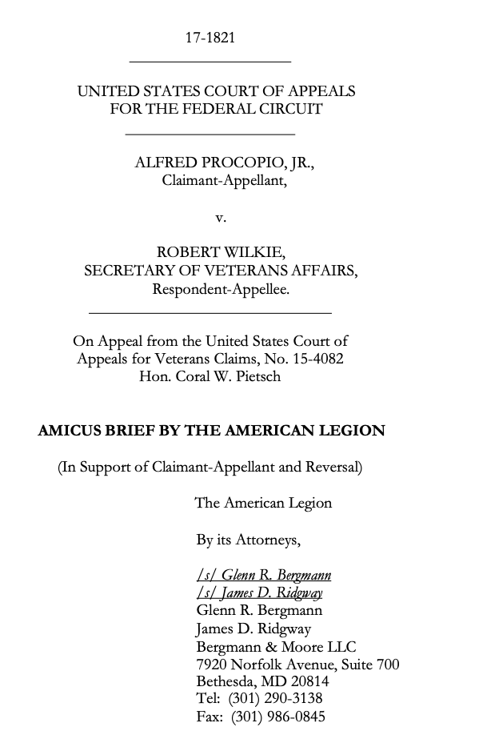
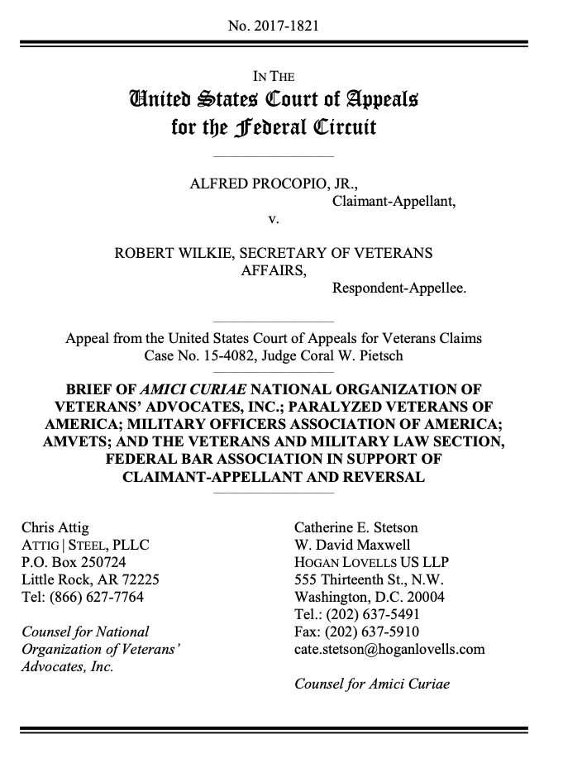
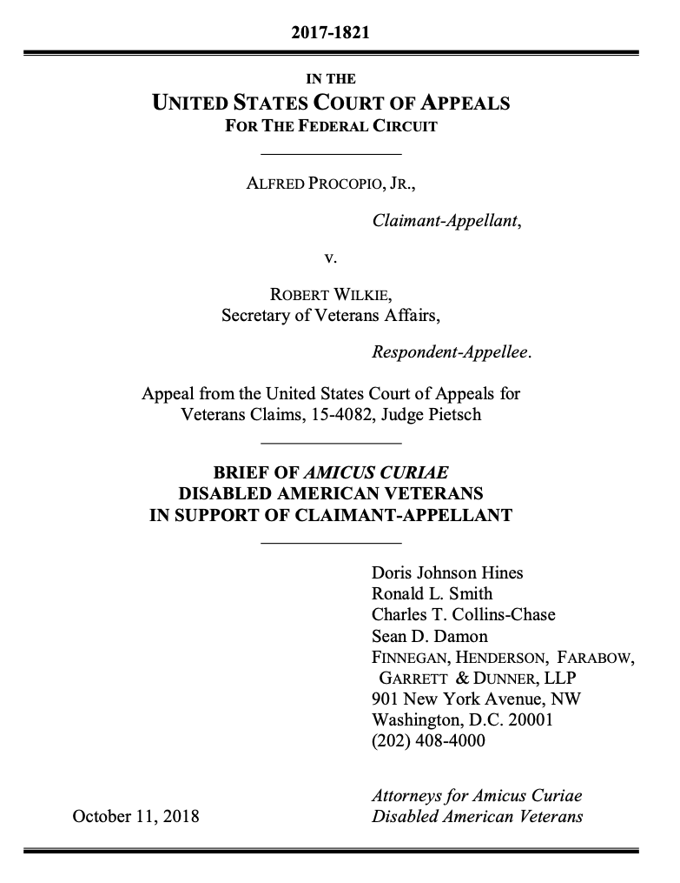
Making your case
With a little help from your friends

