Slide 1
Discrimination in the
Military and Thereafter:
MU VETERANS CLINIC SYMPOSIUM
United We Stand, Divided We Fall

Slide 2
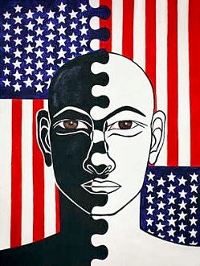
Racism
Extremism
Sexism
Fear-Of-The-Other-ism
Hate
The military is a microcosm of society

Slide 3
UCMJ does not adequately address discriminatory incidents
According to AP News…
FY 2020 – the military processed >750 complaints of racial/ethnic discrimination from service members.
FY 2020 – civilians working in financial, tech, support sectors of Army, AF, Navy filed >1200 complaints of racial/ethnic discrimination.
Deep-rooted racism, discrimination permeate US military, AP News, May 27, 2021

Slide 4
Black service members were far more likely than white service members to face military justice or disciplinary action
According to Protect Our Defenders…
USAF – Black airmen are 70% more likely to face court-martial or non-judicial punishment (NJP) than white airmen. (2006-2015)
USMC – Black Marines are 32% more likely to receive a guilty finding at court-martial or NJP proceeding. (2006-2015)
USN – Black sailors are 40% more likely to be referred to special or general court-martial. (2014-2015)
USA – Black soldiers are 61% more likely to face special or general court-martial. (2006-2015)

Slide 5
the Air Force acknowledged:
In response to POD’s FOIA request…
“Diversity is a national security imperative, and we understand, in order to recruit and retain a diverse population of Airmen, they must have confidence that our system is free of any unlawful discrimination.”

Slide 7
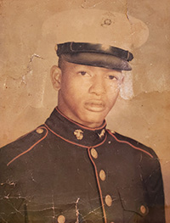
Conley Monk, Jr.
Racial discrimination in & after service
In 1970, Mr. Monk accepts undesirable discharge in lieu of facing misconduct charges.
He’s denied discharge upgrade & VA benefits.
In 2011, psychiatrist diagnoses PTSD – during and since service.
BCNR upgrades his discharge; VA grants benefits.
In 2021, VA discloses records revealing a statistically significant difference in disability decisions based on race from 2001 to 2020.
In 2022, Mr. Monk sues VA under FTCA for the harm caused by these racial disparities.

Slide 8
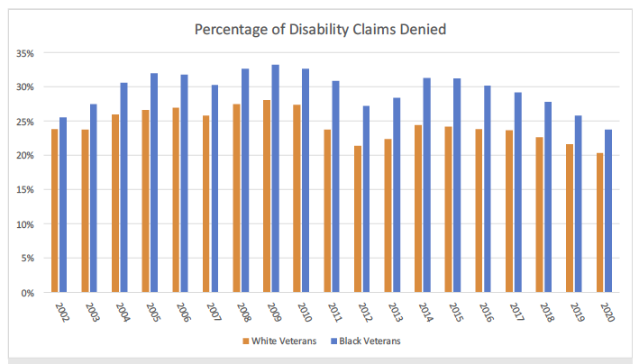
Racial discrimination in VA benefits
Disparity in VA grants & denials

Slide 9
Sexual Harassment & Gender Discrimination, Army
RAND STUDY, 2020
Female Soldiers most commonly experience gender discrimination (being ignored, mistreated, or insulated; sexist comments about ability to do the job); repeated attempts at unwanted intimate/sexual relationship; and sexual comments about appearance or body.
Male Soldiers most commonly experience insults to their masculinity, sexual orientation, or gender expression.
Both male and female Soldiers typically also experience repeated sexual jokes and offensive or persistent discussions of sex.

Slide 10
Sexual Harassment & Gender Discrimination, Army
RAND STUDY, 2020
48 percent of female Soldiers indicate that at least one of the alleged perpetrators was their supervisor or someone in their chain of command.
Male Soldiers are less likely to report being harassed by a supervisor or another member in their chain of command (39 percent).
Female and male Soldiers experience multiple forms of sexual harassment and gender discrimination at one time, but female Soldiers experience significantly more types of harassment/discrimination behaviors, on average, than male Soldiers do.

Slide 11
Sexual Harassment & Gender Discrimination, Army
RAND STUDY, 2020
Female Soldiers’ experiences of sexual harassment and gender discrimination are more likely than male Soldiers’ to be persistent and to cut across more times and places.
Female Soldiers experience more types of sexual harassment/gender discrimination behaviors, on average, than male Soldiers do.
Regardless of whether victims are male or female Soldiers, experiences of sexual harassment and gender discrimination are primarily committed by male service members, especially enlisted members, and frequently occur at the Soldiers’ place of duty during the duty day (rather than during Soldiers’ off hours).

Slide 12
38 C.F.R. § 3.304(f)(3) versus 38 C.F.R. § 3.304(f)(5)
REGULATORY DISCRIMINATION?
§ 3.304(f)(3) – if the veteran’s PTSD is based on ”fear of hostile military or terrorist activity,” the veteran’s lay testimony alone may establish the occurrence of the claimed in-service stressor.
§ 3.304(f)(5) – if a veteran’s PTSD is based on in-service personal assault, the veteran’s lay testimony is not enough. It must be “corroborated” by other sources.

Slide 13
AZ v. Shinseki, 731 F.3d 1303 (Fed. Cir. 2013)
CASE LAW
VA and the CAVC “may not rely on a veteran’s failure to report an in-service sexual assault to military authorities as pertinent evidence that the sexual assault did not occur.” AZ v. Shinseki, 731 F.3d 1303, 1306.
“[W]here an alleged sexual assault, like most in-service sexual assaults, is not reported, the absence of service records documenting the alleged assault is not pertinent evidence that the assault did not occur.” Id. at 1318.

Slide 14
Nelson Mandela, Long Walk to Freedom
Final word…
“No one is born hating another person because of the color of his skin, or his background, or his religion. People must learn to hate, and if they can learn to hate, they can be taught to love, for love comes more naturally to the human heart than its opposite.”

