Slide 1
Discrimination in Claims and C&P Exams
Symposium Hour Five
The Story of Veteran Reginald (Reggie) Waxter, Comments by Dr. Amy Beebe and Amy Odom. Esq.

Slide 2

Is there Discrimination in VA Claims & Exams?

Slide 3
Let’s look at Reggie Waxter’s Claim Process
But first let’s look at the landscape in which his claim was processed

Slide 4
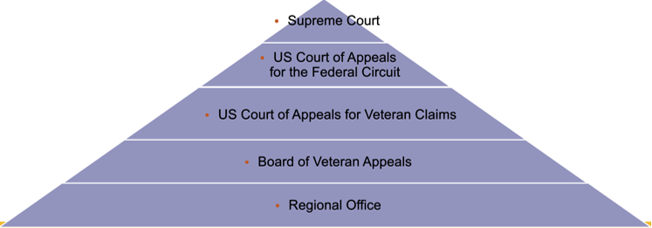
BENEFITS CLAIM HIERARCHY
DISCRIMINATION IN C & P EXAMS

Slide 5
WAXTER CLAIM CHRONOLOGY > C&P EXAM
DISCRIMINATION IN C & P EXAMS
2012 – Initial claim ​filed for PTSD
2016 VA Examination​
  Stated Stressors
    (1) Involvement in a riot during service, leading to jail
    (2) Witnessing a stabbing in prison​
    (3) Being subjected to harassment by guards in prison​
Examiner analysis​
  Stressors (2) and (3) are the ones which underlie PTSD
RESULT of EXAM: Reggie receives no benefits because…..

Slide 6
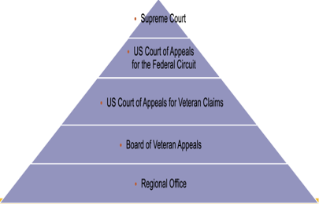
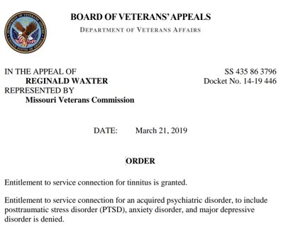
WAXTER CLAIM CHRONOLOGY: BOARD DENIAL
DISCRIMINATION IN C & P EXAMS
". . . the weight of the evidence shows that the Veteran's PTSD relates to his experience of being incarcerated in Scotland—a period not considered to be active service under VA regulations."

Slide 7
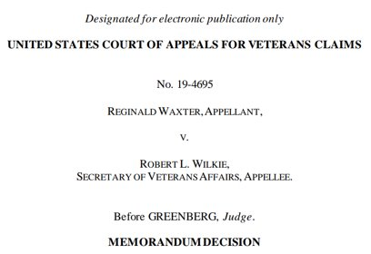
WAXTER CLAIM CHRONOLOGY: CAVC APPEAL AND REMAND (November 30, 2020)
DISCRIMINATION IN C & P EXAMS
“The Board erred in failing to return the July 2016 examination for clarification.”​
“The fact that the appellant has PTSD based on the stabbing he witnessed in prison does not foreclose the possibility that the appellant may also have compensable PTSD related to the riot.”​
“The examiner did not answer the question whether the appellant’s distressing dreams, avoidance of crowds, and other symptoms related to the riot were sufficient to warrant a diagnosis.”

Slide 8
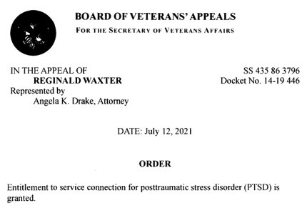
WAXTER CLAIM CHRONOLOGY: BOARD FINALLY GRANTS CLAIM
DISCRIMINATION IN C & P EXAMS
“The most recent examination was completed in May 2021 and the examiner found a single diagnosis of PTSD. In an addendum to the examination report, the examiner found that the Veteran's PTSD was more likely than not caused by his noted stressors, which are adequate to support the diagnosis and associated with his fear for his personal safety and witnessing the stabbing death of another."​

Slide 9
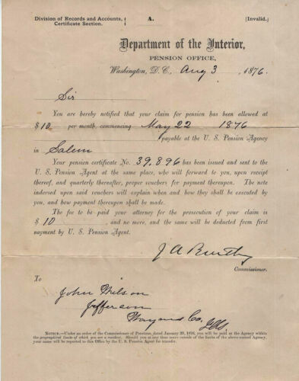
HISTORY OF DICRIMINATION IN THE U.S. PENSION SYSTEM
DISCRIMINATION IN C & P EXAMS
Civil War: Sven E. Wilson – PREJUDICE & POLICY Racial Discrimination in the Union Army Disability Pension System
  Sick and injured Black soldiers less likely to be hospitalized (lack of medical records)
  Lack of property and literacy resulting from slavery
  Race-neutral policies outweighed by prejudicial bias

Slide 10
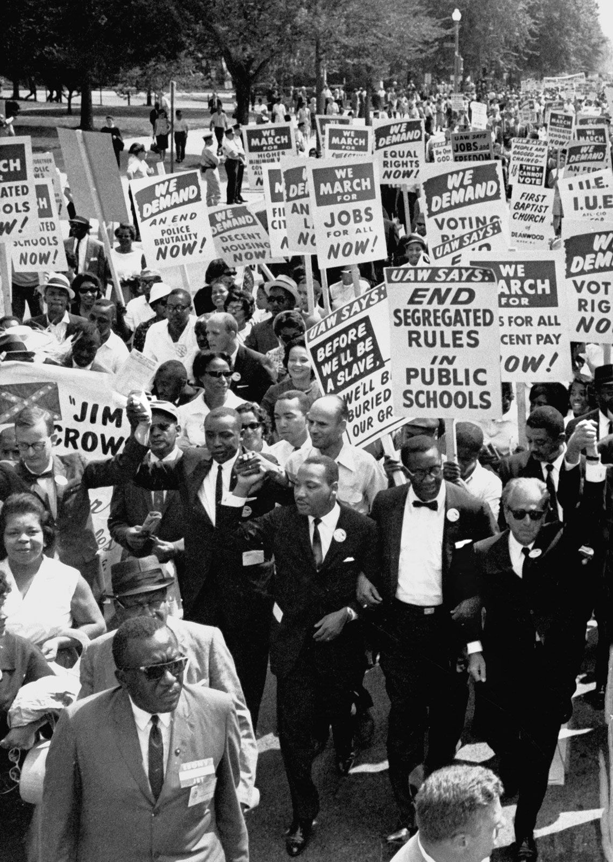
HISTORY OF DICRIMINATION
Civil Rights Era
  As it relates to the Navy, black sailors were typically assigned to the less desirable jobs
  Numerous race riots aboard Navy ships: Kitty Hawk, Constellation, Hassayampa, etc.
  Treatment in service reflected in treatment after service
Modern Day
  While the gap continues to close, some of the same discriminatory factors are still present
  The residual effect of past discrimination is that the majority of economically disadvantaged veterans, those with little support or access to services, are veterans of color.

Slide 11
Is Mr. Waxter's Experience Isolated and Atypical?
Marx, Rebitzer, Bovin, Guilbert, Moshier, Gallagher, Holowka, Rosen, Kean, The Influence of Veteran Race and Psychometric Testing on Veterans Affairs Posttraumatic Stress Disorder (PTSD) Disablity Exam Outcomes​
  "Black veterans were significantly less likely than White veterans to receive a PTSD diagnosis from their C&P examiner. . . ."​
Yale Class Action​ - Conley Monk - "statistically significat difference in VA disability compensation claim determinations based on race from 2001 to 2020"

Slide 12
Other cases of discrimination in the military? Is Mr. Waxter alone?
Evan R. Seamone, Disability Compensation for the Psychological Impact of Race Discrimination: Lessons from the Board of Veterans’ Appeals asserts the following:
  Documented trends from over 1 million Board decisions from 1993-2019
  Through 2015, VA denied more discrimination claims than it granted
    Veterans had greater success if alleging anxiety or depression instead of PTSD for discrimination
    Greater success if multiple mental health disorders
    Biggest hurdle – meeting “trauma” requirement
    Other hurdle – VA regulatory requirement for independent corroborating evidence that the discriminatory event occurred, not required for other mental health disorders
    Over two dozen BVA decisions contained “sanitized” descriptions of the discriminatory events
  * In 2017, Seamone found approval rates increased

Slide 13
FIXES?
Seamone Recommendations to discuss:
  Judges should ”articulate specific facts in all discrimination cases to ensure that the public can accurately assess case trends.”
  Mental health evaluators should “use established and objective psychiatric tests designed to measure the impact of racial discrimination, such as the Race-Based Traumatic Stress Symptom Scale or the UConn Racial/Ethnic Stress & Trauma Survey.”
  “(G)reater outreach to veterans to educate them that VA discrimination claims are not only winnable, but most likely to succeed at the present time." ​

Slide 14
Questions?

